Slide 1


WP4: Train-the-Trainer
CPD Programme
Module 6: Integrating Sustainability Across VET Programmes
Elaborated by: Group for European Integration [GIE]
Funded by the European Union. Views and opinions expressed are however those of the author(s) only and do not necessarily reflect those of the European Union or the European Education and Culture Executive Agency (EACEA). Neither the European Union nor EACEA can be held responsible for them. Project Number: 2024-1-PT01-KA220-VET-000252771
Notes:
"Welcome to the module “Integrating Sustainability Across VET Programmes”.
Today we will explore how sustainability can be embedded into training systems and how you, as trainers, can deliver sustainability-focused learning effectively."
The trainer introduces him/herself.

Slide 2

Session Roadmap
Today’s 3-hour session includes:
Module introduction and learning outcomes
Key concepts and examples
Practical activity
Application to training practice
Reflection and self-directed learning task
Notes:
By slides 2,3,4 the trainer presents the Module Overview …
S/he explains:
✔ 3 Topics
✔ Session flow
✔ Expected outputs
Image source:
Image created with Sora (AI‑generated), for SUSTAIN‑EU CU4 “Module Aim & Introduction”. No third‑party content; no identifiable people or brands. Prompt archived in project records.

Slide 3

Module Overview
This module focuses on:
Topic 1: Strategies for Embedding Sustainability across VET Programmes
Topic 2: Planning and Delivering ESE Training Sessions
Topic 3: Professional Practice, Collaboration and Continuous Improvement
By completing this module, trainers will be better prepared to:
Integrate sustainability across VET programmes
Design and facilitate ESE training sessions
Apply systems thinking and sustainability approaches
Adapt training materials to local contexts
Use monitoring and continuous improvement practices
Engage in collaboration and peer learning
Support sustainability-focused professional practice
Notes:
The trainer says: “Across the module, the three topics are not delivered as distinct sequential units, but they are approached as interconnected and complementary areas of learning, with concepts, activities, and reflections intentionally overlapping to support an integrated understanding of sustainability in VET practice.”
Image source: Image created with Sora (AI‑generated), for SUSTAIN‑EU CU4 “Module Aim & Introduction”. No third‑party content; no identifiable people or brands. Prompt archived in project records.

Slide 4

Topic 1: Strategies for Embedding Sustainability across VET Programmes
Key topic 1 “Strategies for Embedding Sustainability across VET Programmes” focuses on practical methods for integrating sustainability across curricula, including curriculum mapping, systems thinking, stakeholder engagement, and continuous improvement approaches.
Notes:
Image Source: image created with BING by Georgeta Chirlesan

Slide 5

Topic 2: Planning and Delivering ESE Training Sessions
Key topic 2 “Planning and Delivering ESE Training Sessions” focuses on designing facilitation plans aligned with the ESE curriculum, selecting appropriate learning methods, and adapting materials for diverse learning contexts.
Notes:
Image Source: image created with BING by Georgeta Chirlesan

Slide 6

Topic 3: Professional Practice, Collaboration and Continuous Improvement
Key topic 3 “Professional Practice, Collaboration and Continuous Improvement” supports trainers in strengthening their professional practice through reflective learning, peer collaboration, and quality assurance processes. Trainers explore how to document and evaluate their facilitation practices, contribute evidence to their ongoing Trainer Portfolio, engage in peer moderation, mentor new trainers, and participate in national and transnational trainer networks. Emphasis is placed on continuous improvement and sustaining the quality and impact of ESE training across different institutional contexts.

Slide 7
Learning Outcomes
This module addresses the following Learning Outcomes:
K7: Outline methods for integrating sustainability across VET programmes, including monitoring, reporting, and continuous improvement.
S6: Develop and implement facilitation plans aligned with the six modules of the ESE curriculum.
S7: Compile and manage a Trainer Portfolio demonstrating learning design, quality assurance, accessibility, and reflection.
AR1: Facilitate the ESE course independently, ensuring pedagogical, ethical, and technical quality.
AR2: Adapt materials and examples to local or institutional contexts while maintaining the European quality-assurance framework.
AR3: Mentor new trainers and contribute to national and transnational ESE trainer networks.
AR6: Engage in peer moderation and continuous improvement, contributing to the sustainability of the ESE training ecosystem.
Notes:
At the end this slide, the trainer says: "This module will help you develop the skills needed to integrate sustainability into your programmes and deliver ESE learning effectively."

Slide 8

What is sustainability​
Sustainability: The ability to meet present needs without compromising future generations, balancing environmental, social, and economic aspects.
Sustainable Development: A development model that seeks economic growth combined with environmental preservation and social inclusion.
Sustainable Communities: Communities that manage natural, human, and financial resources to ensure current and future quality of life, promoting inclusion and social participation.
Triple Bottom Line: An approach that evaluates an organisation’s performance considering three dimensions: social (people), environmental (planet), and economic (profit).
Notes:
By this and the next slide, the trainer’s purpose is to introduce sustainability as a structured system…
At the beginning of this slide the trainer says: "We begin by reflecting on what sustainability actually means in business, education and training."
Note: Content taken from slide 4 / CU1 from ESE course

Slide 9
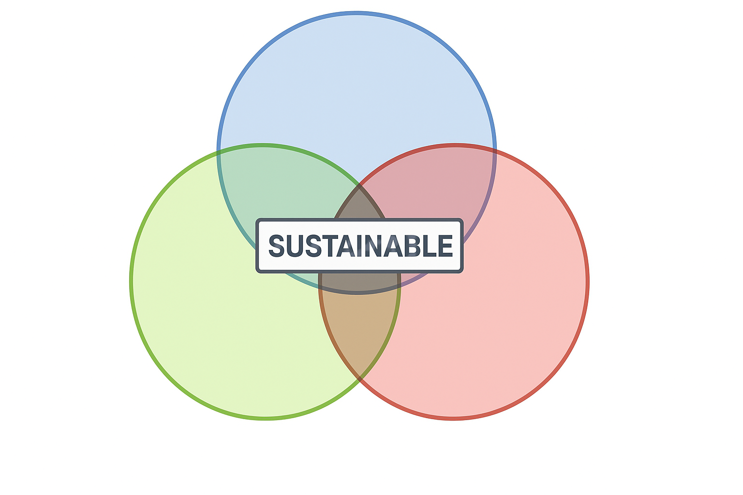
Overview on Sustainability vision
Sustainability – Elkington’s triple bottom line
First published in 1997, John Elkington’s triple bottom line concept depicts a business world with outstanding performances in three main areas:
  Social
  Environmental, and
  Economic
rather than solely focusing on generating
profit, or the standard “bottom line.”
“Society”
“Bearable”
“Equitable”
“Environment”
“Economy”
“Viable”
Notes:
Note: This is slide 6 / CU1 from ESE course
The triple bottom line is a business concept that states firms should commit to measuring their social and environmental impact - in addition to their financial performance - rather than solely focusing on generating profit, or the standard “bottom line.”
In 1994, the concept of triple bottom line was introduced into the business world as the new sustainability taxonomy embracing new guidelines for industries to undertake and address the set of sustainable development goals (SDGs) established in the United Nations Rio+20 summit and the following Millennium Development Goals (MDGs) from 2015 on. The concept was introduced as a new challenge for businesses to include security of people and the planet in the strategic business model and to develop new instruments and taxonomies to assess the prejudices that are being caused to society and environment (Griggs et al., 2013). In Cannibals with forks: The triple bottom line of 21st century business, Elkington (1997) postulates the 3Ps designation for people, planet, and profits as a triple goal toward true sustainability. By his definition, industries should assess the three segments when planning their strategies as all three of them are characterized by the same importance, not only accounting for the financial returns (Moneva, Archel, & Correa, 2006). To be successful in a truthful triple bottom line development, a company should consider having all three aspects with positive returns. Decreasing the level of negative outcomes is not considered by Elkington (1998) a solution to the environmental and societal problems we have been facing, as settled and established in the MDGs.
Dating back from 1997, Elkington’s concept has been constantly applied and reformulated in several contexts.
First published in 1997, Cannibals with forks: The triple bottom line of 21st century business (Elkington, 1997) depicts a business world with outstanding performances in three main areas: social, environmental, and economic.
25 Years Ago I Coined the Phrase “Triple Bottom Line.” Here’s Why It’s Time to Rethink It.
by John Elkington
June 25, 2018
https://hbr.org/2018/06/25-years-ago-i-coined-the-phrase-triple-bottom-line-heres-why-im-giving-up-on-it
Image source: https://www.researchgate.net/publication/299535510_Finding_the_Copper_Mine_of_the_21_st_Century_Conceptual_Exploration_Targeting_for_Hypothetical_Copper_Reserves

Slide 10

Sustainable Education
Conceptual delimitations (1)
Sustainable education and sustainability education (or Education for Sustainable Development - ESD) are closely related terms and often used interchangeably in the general discourse, but academic and specialized contexts recognize a distinction between them.
Definition of sustainable education refers to the sustainability of the educational system, rather than the teaching about sustainability.
Notes:
Note: Content represents part of the slide 7 / CU2 from ESE course
Image Source: https://www.freepik.com/free-photo/mini-globe-top-textbook-pile_4924061.htm#fromView=keyword&page=1&position=1&uuid=7bd5765a-b99f-4724-8f73-5746420709fd&query=Sustainable+education

Slide 11
Sustainable Education
Conceptual delimitations (2)
Sustainable Education
Is a system of learning that aims at addressing the social, economic, and physical environment, whose intended learning outcomes are to equip the learner with the knowledge skills, attitudes, and values required to support a sustainable future (Shivam, 2025).
Integrates the principles of sustainability into the curriculum and pedagogy, teaching not only about the environmental but also economic & social dimensions of sustainability, and how they interconnect (Teaching with Europeana, 2024).
Sustainability Education
(or Education for Sustainable Development – ESD)
Is education approach that aims to develop students, schools, and communities with the values and the motivation to take action for sustainability, in their personal lives, within their community and at a global scale, now and in the future. (Elegbede et. al., 2023)
Empowers people with the knowledge, skills, values, attitudes and behaviors to live in a way that is good for the environment, economy, and society. It encourages people to make smart, responsible choices that help create a better future for everyone. (UNESCO, 2025)
Notes:
Note: The content represent parts of the slides 8, 9 and 10 / CU2 from ESE course
After presenting this slide the trainer emphasizes that “Sustainable Education” and “Sustainability Education” are distinct concepts, yet strongly connected and very important both!
The trainer concludes:
“Though distinct in focus - one as a curricular component (Sustainability education) and the other as a holistic framework (sustainable education) - both are interconnected, essential, and equally important for fostering active, informed citizens capable of creating a sustainable future.”

Slide 12
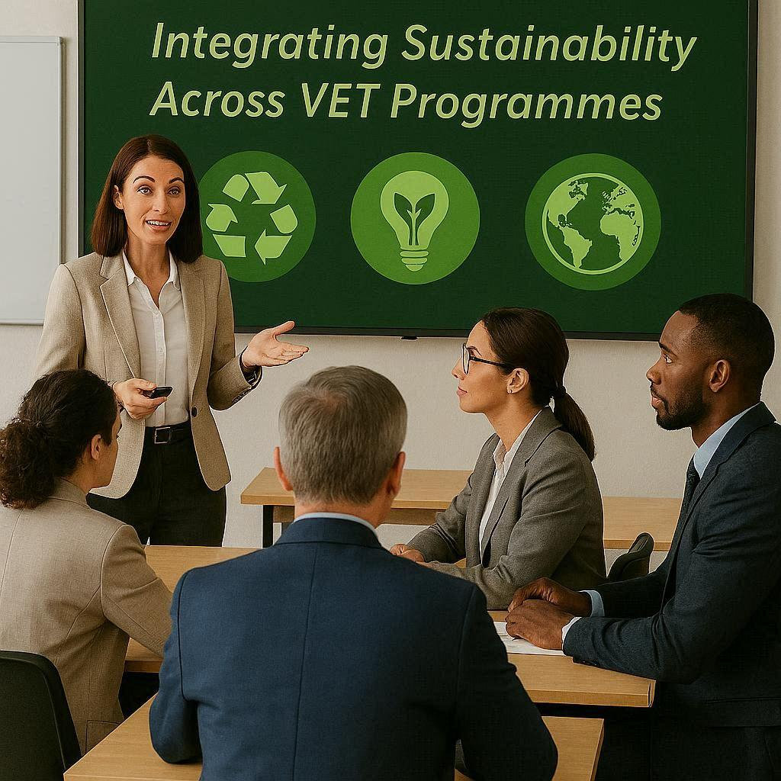
Brief Opening Group Reflection
What does sustainability mean in your training context?
Notes:
The trainer allows 2-3 answers…(participants can answer, for example: environmental responsibility; resource efficiency; ethical behavior; social inclusion).
Image source: image created with BING by Georgeta Chirlesan

Slide 13

PERSONAL REFLECTION ACTIVITY
Worksheet 1:
Sustainability in My Training Practice
Notes:
The trainer says: "Before learning new approaches, we need to understand where sustainability already exists in our training."
The trainer distributes Worksheet 1 and explains the task. Allows participants to work few minutes.
Collects worksheets and says: "Who would like to share one challenge?" and invites 2-3 participants to answer.
Typical challenges that participants may emphasize are:
Limited teaching materials
Lack of time
Institutional resistance
Lack of examples
The trainer concludes that “These responses reflect common barriers to sustainability transitions, including resistance to change and limited awareness.”
Image source: free emoji from Vecteezy: https://www.vecteezy.com/free-png/think-emoji

Slide 14

Creative Thinking
Picture
Creative thinking gets together key attributes for addressing complex sustainability challenges and driving meaningful transitions.
While combining the following approaches, it enables solutions that are creative, systemic, and resilient:
  Systems thinking – allows systemic insight into feedback loops and system resilience
  Design thinking – towards empathy-driven, context-sensitive solutions
  Futures literacy – enhances forward-looking and adaptable mindsets.
  These approaches – Design thinking, Systems thinking and Futures literacy – can lead the way to sustainability transitions.
CREATIVITY
Notes:
Note: This is slide 9 / CU3 from ESE course
By presenting this slide, the trainer introduces participants in the Systems Thinking…s/he can provide verbally examples of systems, taken from slide 10/CU3 from ESE course (our bodies, our global trade and transportation systems)…

Slide 15
Creative Thinking
Systems thinking
Core principles:
Holistic perspective: Focus on systems as interrelated wholes rather than isolated parts
Feedback loops & interdependence: Recognises causal chains and dynamic relationships that shape system behaviour
Identification of leverage points: Pinpoints where small interventions generate significant change, crucial for systemic transformation.
Application to sustainability:
Systems-based models (e.g., SDG Interlinkages frameworks) help assess complex SDG trade-offs
New AI-enhanced platforms, like SYMBIOSIS, use systems thinking to support societal challenges and the SDGs by mapping causal structures and enhancing stakeholder understanding
Notes:
Note: This is slide 13 / CU3 from ESE course
The trainer presents the core principles…
Major global crises including climate change, pandemics, inequalities, polarization, and geopolitical tensions are making the business environment more complex and turbulent than ever before. That’s why many thought leaders see systems thinking as one of the most crucial management skills of the 21st century.

Slide 16
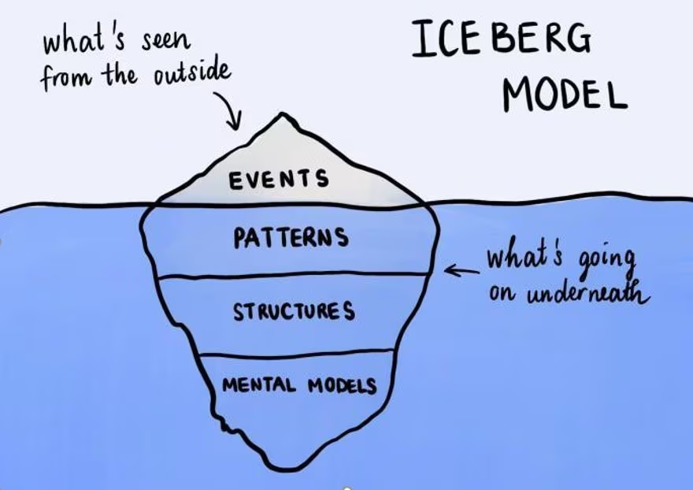
Creative Thinking
Systems thinking
The Iceberg model
Event: What is the specific problem or opportunity?
Patterns/trends: What trends /patterns have there been over time?
Underlying structures: What has influenced these patterns and how are they interconnected?
Mental modes: What assumptions, beliefs and values do people hold about the system?
What’s seen from outside
ICEBERG MODEL
EVENTS
PATTERNS
What’s going on underneath
STRUCTURES
MENTAL
MODELS
Notes:
Note: This is slide 14 / CU3 from ESE course
By slides 14, 15, 16 the trainer emphasizes understanding sustainability problems as interconnected systems requiring holistic perspectives.
The trainer says "Sustainability challenges are rarely simple - they are systems."
S/he points to iceberg diagram.
Then says "What we see is only the visible part."
S/he explains the systems components (events, patterns, structures, mental models - and emphasizes that these layers help identify root causes and systemic change opportunities).
---------------------
A tangible example to all – understanding causal relationships and effects during COVID-19 in a bank branch, also is a digitalisation / dematerialisation example
Mapping exercise
World Economic Forum - What 'systems thinking' actually means - and why it matters for innovation today
(https://www.weforum.org/stories/2021/01/what-systems-thinking-actually-means-and-why-it-matters-today/)
To illustrate how systems thinking applies in business, let's use a simplified example of a bank branch.
Event: COVID-19 declared a pandemic, lockdown implemented for all people and businesses, except key workers and essential firms. Branches are shutting, people are afraid to go to non-essential establishments.
Patterns/trends: what trends have there been over time? Scientists have warned us about being ‘pandemic-ready’ for years, but we have had misinformation or a lack of transparency from other ‘systems’ who should have been driving this.
However, what about banking patterns? More customer service has moved online, digital banks and fintech developments have decreased the urgency for face-to-face business in branches. Are there trends in customer behaviours? More consumers are searching for all their products and services online, and this was common before the pandemic had begun.
Underlying structures: what has influenced these patterns and how are they interconnected? A growing desire for digitalised experiences and convenience is popular in financial services and customers will begin to seek and only interact with businesses who have the infrastructure to operate this way. A minimal number of touchpoints is seen as desirable, providing quicker, stress-free experiences, as consumers want to spend less time on these engagements when work-life balance has become more integrated, and therefore is important to preserve.
Mental models: what assumptions, beliefs and values do people hold about the system? Behavioural economics tells us that customers will adapt and change their consumer spending habits. Used to the convenience of online, less relevance will be seen for branches, and banks will need to further adapt. The ‘new normal’ will contain old and new beliefs. Which ones keep bank branches in place? Human contact and customer service? The agency in dealing with your finances face-to-face? Will a new experience or service be required to keep bank branches relevant or are online digital banks all consumers will need?
Beyond this, do banks have an ethical obligation to monitor spending habits to identify signs of debt and underlying mental health problems? What relationship should banks have with data? How do they balance intuitive service with consumer privacy?
Going through the layers of this iceberg unearths part of the power from using systems thinking and exemplifies how to guide your strategy in a sustainable way.
Only focusing on events? You’re reacting.
Thinking about patterns/trends? You’re anticipating.
Unpicking underlying structures? You’re designing.
Understanding mental models? You’re transforming.
Transformative thinking is how we innovate and systems thinking is essential for this journey.

Slide 17

SHORT DISCUSSION
What hidden systems influence sustainability in your VET programme?
Notes:
The trainer asks participants: "What hidden systems influence sustainability in your VET programme?"
Potential answers (examples of answers):
Policies
Habits
Infrastructure
Culture
Image source: image created with BING by Georgeta Chirlesan

Slide 18
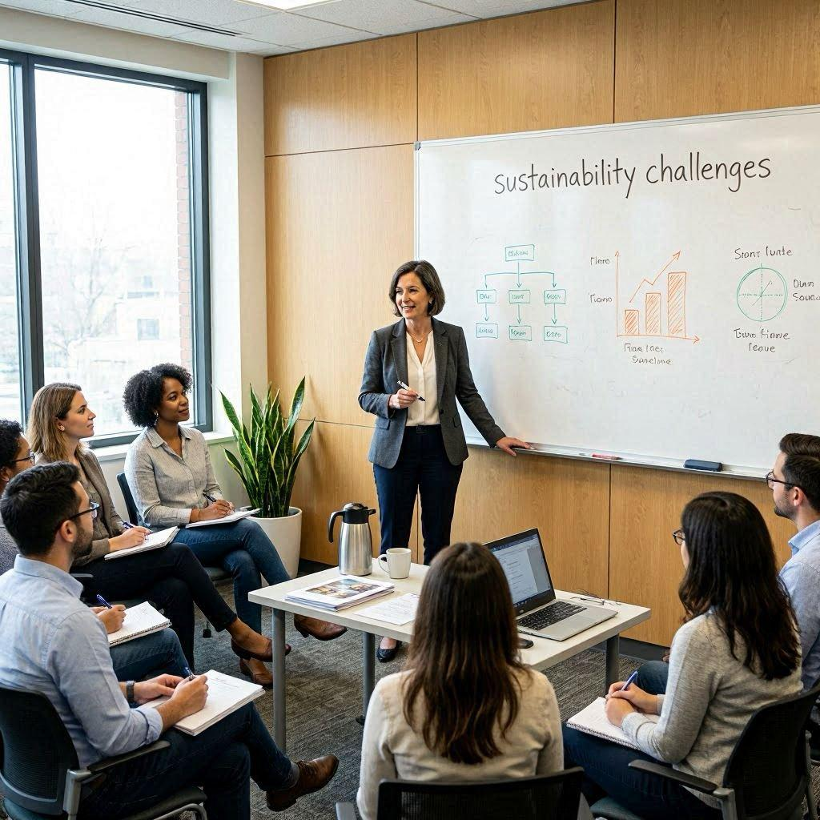
APPLIED DISCUSSION
What patterns do you observe in sustainability challenges?
Notes:
The trainer says: "The Iceberg Model helps us move from reacting to problems toward understanding root causes."
And provides the explanations given in the notes of slide 16 (“A tangible example for all etc.”)…
S/he asks participants: "What patterns do you observe in sustainability challenges?"
Possible Responses (examples):
• Increasing waste
• Resource inefficiency
• Repeated behaviour
Image source: image created with BING by Georgeta Chirlesan

Slide 19
Strategy & Stakeholders
Stakeholder Mapping
Map internal and external stakeholders (e.g. employees, unions, customers, suppliers, regulators, communities).
Use a power/interest grid to place each group in the appropriate quadrant.
Define engagement actions per quadrant – e.g. inform, consult, involve, collaborate/partner.
Capture key expectations, concerns and opportunities from each group in a simple log.
Use the map to design your communication plan and to decide who to involve in co‑creating the plan.
Notes:
Note: This is slide 8/CU5 from ESE course
The trainer says: "No sustainability initiative succeeds without stakeholder involvement. So, you always need to do the stakeholder identification, the stakeholder mapping."
Then s/he presents this slide „Stakeholder Mapping“ and explains:
• Internal stakeholders
• External stakeholders
• Sustainability relationships

Slide 20

PRACTICAL ACTIVITY
Worksheet 2:
Mapping Sustainability in Your VET System
Notes:
The trainer distributes Worksheet 2 and explains the task.
S/he circulates and support participants by asking "Who influences sustainability in your training?" and providing guidance to navigating the tasks in the worksheet.
Image source: free emoji from https://walkingyn.com/wp-content/uploads/2017/06/exercise-cliparts-exercise-cliparts-exercise-workout-clip-art-workout-clip-art-573_363.jpg

Slide 21
Organisational Emissions and Reporting
Scopes 1, 2, and 3
GHG emissions are reported in three scopes (IBM, n.d.):
  Scope 1: Direct emissions from sources the organisation owns or controls, such as on-site fuel use, manufacturing processes, or fugitive emissions.
  Scope 2: Indirect emissions from purchased electricity, heat, or steam. Reporting can use location-based or market-based calculations.
  Scope 3: Indirect emissions from the wider value chain, including suppliers, business travel, and product use. Not required to report under GHG Corporate Protocol.
GHG accounting covers seven main gases (CO₂, CH₄, N₂O, HFCs, PFCs, SF₆, NF₃), all converted to CO₂-equivalents. Scope 3 is optional under the Corporate Standard but can be reported using the Scope 3 standard.
Using emission scopes helps organisations identify risks and opportunities, set and track reduction targets, and improve transparency. They also provide a basis for assessing environmental impacts, such as carbon footprint, energy and water use, and waste generation, and for prioritising mitigation strategies (Beyond Team, 2025; Fiveable, 2025)
Notes:
Note: This is slide 21/CU7 from ESE course
The trainer says: "Sustainability must be measurable."
S/he explains, by using slides 20, 21, the scope logic and emphasizes that “These scopes classify emissions into direct and indirect sources, enabling organisations to identify reduction priorities. Thus these emission categories distinguish direct and indirect emissions and support sustainability tracking and decision-making.”

Slide 22
Organisational Emissions and Reporting
Inventory Boundaries: Organisational and Operational
Inventory boundaries define which emissions are included in a company’s greenhouse gas (GHG) inventory. They are set at two levels:
  Organisational boundaries: Decide which operations are included in the inventory.
  Operational boundaries: Operational boundaries define which emission sources are included in a company’s GHG inventory and how they are categorised into Scopes 1, 2, and 3, based on whether they are direct or indirect.
Organisational Boundaries
Companies select one consolidation approach for their inventory and must apply it consistently across the organisation. Two main approaches are used:
  Equity share: Emissions are reported according to the company’s percentage ownership of an operation, regardless of control. Common in sectors like oil and gas.
  Control approach: Companies report 100% of emissions from operations they control, either financially or operationally, but cannot mix the two. Operational control is the most common method.
Notes:
Note: This is slide 22/CU7 from ESE course

Slide 23
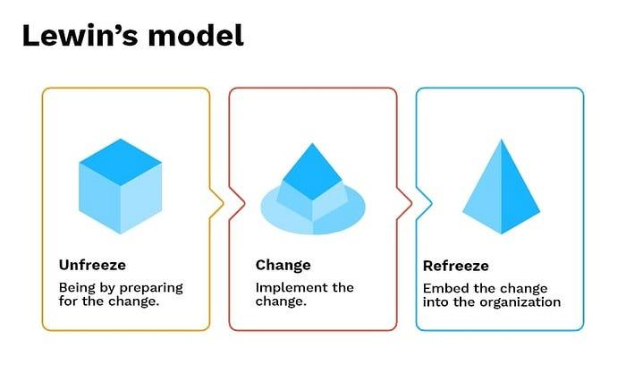
Understanding change in Sustainability contexts
Lewin’ s Change Management Model
Kurt Lewin’s three-stage model remains relevant despite its simplicity:
Unfreeze: creating motivation for change by disrupting the status quo.
Change: implementing the new approaches, with support and communication.
Refreeze: solidifying the change into new norms and practices.
This model recognizes that organizations and people have established equilibriums that must be disturbed before change can occur, and that new equilibriums must be established afterward.
Notes:
Note: This is slide 11/CU8 from ESE course
The trainer says: "Integrating sustainability requires structured change.
In sustainability, change may mean reducing waste, improving energy use, or shifting mindsets.
Key stages of change include:
recognizing the need: understanding why change is necessary.
planning the transition: identifying steps, people, and resources.
implementing change: communicating, training, and supporting people.
embedding new habits: reinforcing and celebrating success.
Change can occur at different levels: individual, team and systemic.
Change management models are concepts, theories, and methodologies that provide an in-depth approach to organizational change.”
And then the trainer presents the 3 models in the slides 23, 24, 25.
The trainer says: “These models support structured implementation of sustainability change in your organisations.”

Slide 24
Understanding change in Sustainability contexts
The ADKAR Change Management Model
The model was developed nearly two decades ago by Prosci founder Jeff Hiatt after studying the change patterns of more than 700 organizations. The ADKAR Model is used by thousands of change leaders around the world.
This powerful model is based on the understanding that organizational change can only happen when individuals change.
ADKAR is an acronym for:
A Awareness – of the need for change
D Desire – to participate and support the change
K Knowledge – on how to change
A Ability – To implement required skills and behaviors
R Reinforcement – To sustain the change
Notes:
Note: This is slide 13/CU8 from ESE course

Slide 25
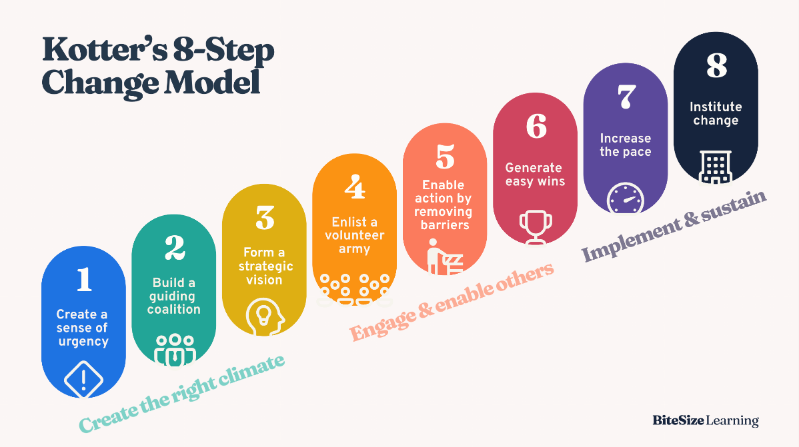
Understanding change in Sustainability contexts
Kotter’s 8 – Step Change Model
Kotter’s 8-step framework provides a path for organizations to overcome the barriers to change success based on research from Dr. John Kotter, an emeritus from Harvard Business School and later founder of Kotter International.
It empowers organizations to accelerate organizational change through proper planning, mobilizing employees, removing friction, and instituting change into a company’s culture. This process enables companies to overcome the challenges faced by constant change, from implementing new technology, changes to organizational structure, new product lines, acquisitions and mergers, and more.
Kotter’s change framework includes eight steps (now called accelerators) used to drive change adoption and enabling organizations to successfully implement new strategies.
For more info:
https://www.youtube.com/watch?v=22coAwMD9M0
Notes:
Note: This is slide 16/CU8 from ESE course

Slide 26

SHORT DISCUSSION
Which change stage is hardest in your organisation?
Notes:
The trainer asks participants: “Which change stage is hardest in your organisation?”
Possible Responses (examples of expected responses):
Resistance
Awareness
Reinforcement
These responses reflect known phases of organisational change processes.
Image source: image created with BING by Georgeta Chirlesan

Slide 27

PRACTICAL ACTIVITY
Worksheet 3: Designing Sustainability Integration
Notes:
The trainer says "Now we move from theory to practice" and explains the group work & expected output and distributes Worksheet 3, through which the participants will use Iceberg Model by working in groups.
During the activity, the trainer circulates among participants, asking guiding questions such as:
"What patterns do you see?"
"What structures influence this?"
Expected outputs from this activity it is that groups identify:
✔ root causes
✔ system patterns/relationships
Image source: image created with BING by Georgeta Chirlesan

Slide 28
Interactive Diagram – SWOT Analysis
Title: Strengths of Sustainable Investments
Subtitle: Strategic advantages and long-term value drivers
Strenghts
  Heading 1: Strengths of Sustainable Investments
  Subheading 1: Strategic advantages
  Pop-up Description: Sustainable investments enhance brand reputation, attract green capital, and strengthen stakeholder trust. They drive innovation, improve resilience, and align business strategy with EU sustainability goals for long-term competitiveness.
  Multimedia: Infographic illustrating the ESG Value Chain (Innovation → Trust → Growth).
Notes:
Note: This is slide 22/CU6 from ESE course
The trainer says: "Next, we analyse the situation strategically."
And explains SWOT by using slides 28, 29,30, 31

Slide 29

Interactive Diagram – SWOT Analysis
Title: Weaknesses of Sustainable Investments
Subtitle: Internal barriers and capability gaps
Weaknesses
  Heading 1: Weaknesses of Sustainable Investments
  Subheading 1: Internal challenges
  Pop-up Description: High initial costs, limited ESG expertise, and inconsistent data quality reduce efficiency. Complex reporting requirements and scarce resources often slow implementation and limit sustainability performance.
  Multimedia: Symbolic image of crossed highways, visualising internal complexity and lack of integration.
https://images.unsplash.com/photo-1625232169171-772503cc56ba?q=80&w=1206&auto=format&fit=crop&ixlib=rb-4.1.0&ixid=M3wxMjA3fDB8MHxwaG90by1wYWdlfHx8fGVufDB8fHx8fA%3D%3D
Notes:
Note: This is slide 23/CU6 from ESE course

Slide 30

Interactive Diagram – SWOT Analysis
Title: Opportunities in Sustainable Investments
Subtitle: Innovation and market potential
Opportunities
  Heading 1: Opportunities in Sustainable Investments
  Subheading 1: Market innovation
  Pop-up Description: Sustainability opens access to growing sectors such as renewable energy, circular economy, and green mobility. It attracts responsible investors, drives innovation, and creates long-term competitive advantage.
  Multimedia: Seedlings in coins represent sustainable investment.
https://cdn.pixabay.com/photo/2017/08/30/07/56/money-2696228_1280.jpg
Notes:
Note: This is slide 24/CU6 from ESE course

Slide 31
Interactive Diagram – SWOT Analysis
Title: Threats to Sustainable Investments
Subtitle: External risks and uncertainty factors
Threats
  Heading 1: Threats to Sustainable Investments
  Subheading 1: External risks
  Pop-up Description: Regulatory uncertainty, greenwashing, and market volatility threaten credibility. Inconsistent ESG standards or unclear definitions can reduce investor trust and slow sustainable finance adoption.
  Multimedia: Circular infographic showing the loop:
  Marketing Claim → Public Skepticism → Regulatory Response → Trust Loss → Reform → New Claim.
Notes:
Note: This is slide 25/CU6 from ESE course
After presenting slide 31, the trainer says: “These analytical tools support structured sustainability planning and risk awareness. Sustainable investment planning includes analysing strengths, weaknesses, opportunities and threats to improve implementation strategies.
Now, you may return to Worksheet 3 and complete Step 4!”

Slide 32
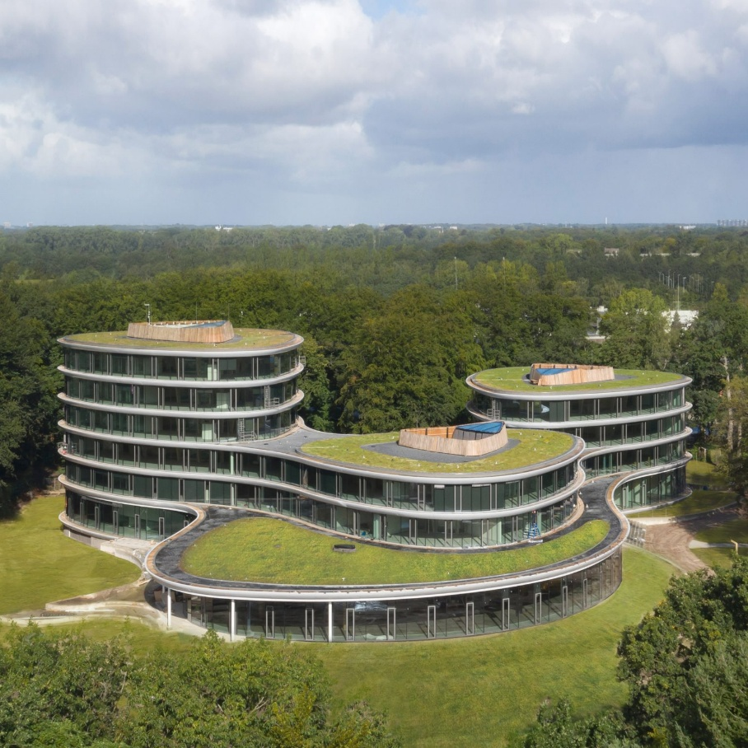
Case Study
Title: Triodos Bank- Pioneer in Sustainable Finance
Overview: The Dutch Triodos Bank is a leading pioneer in sustainable finance.
It invests exclusively in projects with social, cultural or environmental value, demonstrating how banks can embed measurable sustainability into their business strategies.
Links: https://www.triodos.com
https://decmyk.blogspot.com/2021/02/triodos-bank-is-reversible-timber.html
Notes:
Image source:
Note: This is slide 12/CU6 from ESE course
The trainer presents the Triodos Case by using slides 32,33,34

Slide 33
Case Study: Description & Relevance
Description:
Founded in 1980 in Zeist, the Netherlands, Triodos Bank’s mission is to use money as a force for positive change for people and the planet.
It finances only projects with demonstrable social and environmental benefits, including renewable energy, organic farming, education and health.
Its business model combines financial solidity with measurable sustainability performance.
Triodos publishes an annual Impact Report disclosing detailed ESG data, CO₂ reductions and social indicators.
Relevance to the Module:
This case illustrates how sustainable finance principles can be implemented in practice.
It shows that transparency, impact measurement and value orientation are essential components of credible Sustainable Finance strategies – key learning outcomes of CU6 – Sustainable Finance & Operations.
Location: Zeist, Netherlands
Timeframe: Since 1980 – ongoing
Organization: Triodos Bank N.V.
Notes:
Note: This is slide 13/CU6 from ESE course

Slide 34
Case Study: Reflection Questions
Case Study Questions
Introduction:
This reflection aims to connect the insights from the case study to participants’ own professional contexts.
It encourages critical thinking about the credibility, impact and transferability of sustainable finance practices.
Question 1: Credibility: Which measures ensure that Triodos Bank’s sustainability strategy is authentic and verifiable?
Question 2: Impact: How does the bank measure the social and environmental impact of its investments – and which metrics would be relevant for your organization?
Question 3: Which elements of the Triodos model could be adapted to promote sustainable financial decisions in your organization?
Notes:
Note: This is slide 14/CU6 from ESE course
After presenting slides 32,33,34 the trainer says: "This organisation successfully integrated sustainability into financial decision-making."
----------------------------------
Question 1: Credibility
Triodos ensures credibility through strict lending criteria and full transparency on all financed projects.
Each investment is listed publicly in the impact database.
The bank also adheres to external audit standards such as GRI, EU Taxonomy and B Corp certification.
This openness builds trust and prevents greenwashing.
Question 2: Impact
The bank tracks indicators such as CO₂ saved, MWh of renewable energy produced and number of supported education or cultural projects.
These figures are published in the annual Impact Report.
For other organisations, relevant metrics could include energy efficiency, employee wellbeing or local economic value creation.
Question 3: Transferability
Transferable elements include transparent disclosure of investment criteria, clear ESG screening processes, and regular sustainability reporting.
Organisations could also implement internal project evaluation systems aligned with social and environmental goals.

Slide 35

PRACTICAL ACTIVITY
Worksheet 4: Case Study Analysis
Notes:
For slides 35-47:
The trainer explains the tasks & expected output and distributes Worksheet 4.
S/he splits participants in 3 groups and allocate each group one case study (GHG reporting, Slovenia waste case and ILVA case).
Participants analyse:
sustainability actions
transferable lessons
Trainer circulates among participants and asks: "What made this successful?"
Possible Responses (examples of expected responses):
Leadership
Transparency
Measurement
Each group presents results (3-4 minutes each group)
Image source:
Image created with Sora (AI‑generated), for SUSTAIN‑EU CU4 “Module Aim & Introduction”. No third‑party content; no identifiable people or brands. Prompt archived in project records.

Slide 36
Case study 1: GHG Reporting
For Worksheet 4 – Group 1

Slide 37

Case Study
Title: Measuring Emissions: A Guide for Organisations
Overview: This case study examines the New Zealand Ministry for the Environment’s Example GHG Report, demonstrating how a fictional construction company, OPQ Construction Ltd, and its subsidiaries compile a comprehensive greenhouse gas inventory.
It highlights the practical application of the GHG Protocol and ISO 14064-1 standards in measuring, categorising, and reporting both direct and indirect emissions across multiple business units.
Links: https://environment.govt.nz/assets/Publications/Files/example-ghg-report.pdf
Notes:
Note: This is slide 15/CU7 from ESE course
Image source: https://unsplash.com/photos/person-in-black-suit-jacket-holding-white-tablet-computer-nApaSgkzaxg

Slide 38
Case Study: Measuring Emissions: A Guide for Organisations
Description: The case study outlines the structure of OPQ Construction Ltd and its subsidiaries, highlighting the variety of business units, operations, and emission sources. It emphasises considerations such as data collection methods, handling uncertainties, and decisions around inclusion or exclusion of certain emissions, providing a practical context for understanding GHG inventories in real organisations.
Date & Location: 2019, Wellington, New Zealand.
Notes:
Note: This is slide 16/CU7 from ESE course

Slide 39
Case Study: Measuring Emissions: A Guide for Organisations
Case Study Questions
Carefully review the Example GHG Report using the link provided. Focus on how emission sources are identified, classified, and reported across the different business units of OPQ Construction Ltd. After reviewing, answer the questions below.
Question 1: Which business units contribute most to OPQ Construction Ltd’s GHG emissions, and why might this be the case?
Question 2: How are Scope 1, Scope 2, and Scope 3 emissions distinguished in the case study? Give examples of each.
Question 3: What challenges might an organisation face when collecting data for Scope 3 emissions, and how does the case study address these challenges?
Question 4: Identify one emission source that was excluded from the inventory. Explain the reasoning and discuss the potential impact of its exclusion.
Notes:
Note: This is slide 17/CU7 from ESE course

Slide 40
Case study 2: Slovenia Waste Case
For Worksheet 4 – Group 2

Slide 41

Case Study: An Innovative Approach to Organizational Changes for Sustainable Processes on Waste Minimization (Slovenia)
Description: This research explores how a Slovenian company in the coatings industry implemented structured organisational changes for sustainability, achieving an 88% reduction in waste and up to 48% reduction in costs and time in processes.
Link: Krhač Andrašec, E., Kern, T., & Urh, B. (2023). An Innovative Approach to Organizational Changes for Sustainable Processes: A Case Study on Waste Minimization. Sustainability, 15(22), 15706. https://doi.org/10.3390/su152215706
Notes:
Note: This is slide 38/CU8 from ESE course

Slide 42
Case Study: An Innovative Approach to Organizational Changes for Sustainable Processes on Waste Minimization (Slovenia)
Reflective Questions – Case Study: Waste Minimization and Organizational Change (Slovenia)
Understanding the Change context
The company introduced organizational changes to reduce waste and improve process efficiency.
→ What internal or external factors created the need for this change?
💬 Identify at least one environemntal and one economic driver that influenced the decision.
Change Process and Strategy
The project applied a structured approach to redesign production and management systems.
→ Which change management model (Lewin, Kotter, or ADKAR) best explains this transformation?
💬 Explain why the model fits based on the actions or sequence described in the case.
Leadership and Communication
Successful change required leadership commitment and employee involvement.
→ How did leadership behaviour and communication help motivate and engage staff?
💬 Mention one leadership practice that encourages shared ownership of change.
Notes:
Note: This is slide 39/CU8 from ESE course

Slide 43
Case study 3: ILVA Case
For Worksheet 4 – Group 3

Slide 44
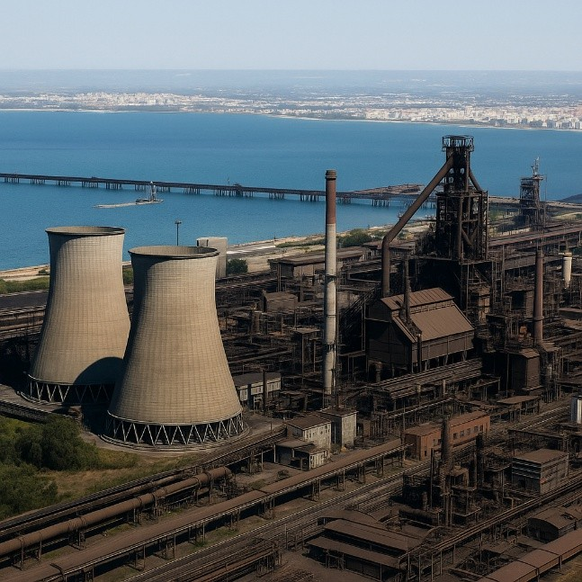

Case study
The ILVA case in Taranto – between industrial production and environmental responsibility
▶ Overview:
▶ The ILVA steel plant in Taranto is a prime example of the conflict between economic development and environmental protection.
Regulatory violations have led to penalties, seizures and remediation plans, highlighting the value of ESG compliance and transparency.
Notes:
Note: This is slide 13/CU9 from ESE course

Slide 45


Case study: The ILVA case in Taranto – between industrial production and environmental responsibility
Description:
ILVA in Taranto, one of Europe's largest steelworks, has been at the centre of a serious environmental and health crisis due to pollution from dust and dioxins.
Judicial investigations have confirmed that emission limits have been exceeded
and that Legislative Decree 152/2006 – Consolidated Environmental Act has been
▶
▶
violated, requiring the implementation of integrated environmental authorisations (IEAs) and remediation plans.
▶
The government and the judiciary intervened with emergency measures, seeking to balance environmental protection, production continuity and employment.
This case shows how crucial it is for companies to adopt sustainable governance
and effective environmental control and reporting systems.
Notes:
Note: This is slide 14/CU9 from ESE course

Slide 46
The ILVA case in Taranto – between industrial production and environmental responsibility
Relevant aspects for the module:
The importance of environmental regulatory compliance as a guarantee of corporate responsibility.
The role of assessment and authorisation tools (EIA, SEA, IEA) in preventing and reducing industrial impacts.
The need for ESG audits and transparent reporting to monitor risks and improve stakeholder confidence.
ILVA as an example of a failure to integrate sustainability, governance and industrial strategy.
Notes:
Note: This is slide 15/CU9 from ESE course

Slide 47
Case study: The ILVA case in Taranto – between industrial production and environmental responsibility
Questions on the case study
▶
▶
Question 1:
What management and governance errors contributed to the environmental crisis at ILVA in Taranto? Identify at least two areas where proper application of environmental regulations (EIA, SEA, IEA) could have prevented or mitigated the damage.
▶
▶
▶
Question 2:
How could an effective ESG strategy have been integrated within the company to balance industrial development and environmental protection?
Propose two practical improvement actions with a view to sustainability reporting and auditing.
▶
▶
Question 3: Question 3:
From the point of view of social responsibility and governance, what lessons can a modern company learn from the ILVA case?
Reflect on how transparency and ESG reporting can influence stakeholder reputation and trust.
Notes:
Note: This is slide 16/CU9 from ESE course

Slide 48
INDIVIDUAL TRAINER REFLECTION ACTIVITY
Worksheet 5:
Reflection and Next Steps
Notes:
The trainer says: "Reflection transforms learning into action."
The trainer distributes Worksheet 5 and explains the task. Allows participants to work 10 minutes.
Then collects the completed worksheets.
Image source: free emoji from Vecteezy: https://www.vecteezy.com/free-png/think-emoji

Slide 49

GROUP REFLECTION ACTIVITY
What is one change that you will implement first?
Notes:
The trainer facilitates group discussion around this question: "What is one change that you will implement first?"
Image source: free image from Magnific, https://www.magnific.com/free-vector/group-therapy-illustration-concept_9907640.htm#fromView=keyword&page=1&position=1&uuid=ed4099ab-ad61-46ac-b825-d60c380893b2&query=Group+reflection

Slide 50

Self-Directed Learning Task
Designing an ESE Training Session
Duration: 1 hour
Participants should:
Select one ESE unit and design a short training activity by using Worksheet 6
Expected output: a lesson plan for a mini-training activity
Notes:
The trainer says: "Your learning continues beyond this session."
S/he distributes Worksheet 6 and explains the mini-training task, namely Designing an ESE Training Session.

Slide 51
Using ESE Materials in This Module
In this module, the following ESE materials are used:
Case studies from CU6
Presentations from all units (CU1-CU9)
Interactive diagram from CU6
These materials are integrated throughout the module and are used during presentations, discussions, practical activities, and case-study analysis as described in the trainer notes.

Slide 52
Practical Activities in This Module
Participants perform specific activities as described in slides and worksheets
Working format: depending on the activity, participants work individual / pairs / groups
Time: between 10 and 45 minutes, depending on the complexity of the task
Material needed: worksheets and case studies

Slide 53
Practical Activities Outputs
By the end of this module, participants should produce:
Programme Integration Design Worksheet
Case Study Analysis
Reflection Worksheet
SDL Mini Training Design Task
Facilitation Planning Evidence
These outputs may contribute to the Trainer Portfolio.

Slide 54

Trainer Portfolio Link
This module contributes to the Trainer Portfolio through:
Sustainability system map
Integration plan
Case analysis
Reflection
SDL training design (lesson plan for mini-training)
Notes:
Image source:
Image created with Sora (AI‑generated), for SUSTAIN‑EU CU4 “Module Aim & Introduction”. No third‑party content; no identifiable people or brands. Prompt archived in project records.

Slide 55
Summary and Next Steps (1)
In this module, we covered:
Sustainability integration in VET requires a whole-system approach.
VET trainers play a key role in promoting sustainable practices.
Systems thinking helps address complex sustainability challenges.
Sustainability education should be interactive, reflective, and learner-centred.
Stakeholder engagement supports successful sustainability integration.
Planning, monitoring, and continuous improvement are essential for impact.
Notes:
Image source:
Image created with Sora (AI‑generated), for SUSTAIN‑EU CU4 “Module Aim & Introduction”. No third‑party content; no identifiable people or brands. Prompt archived in project records.

Slide 56
Summary and Next Steps (2)
Key takeaways from this module:
Change management models support sustainability transitions in organisations.
Real-world case studies strengthen practical sustainability understanding.
ESE materials should be adapted to local and sector-specific contexts.
Reflection and collaboration support continuous professional development.
The Trainer Portfolio documents learning, practice, and improvement.
Sustainability education empowers learners to contribute to sustainable development
Next steps:
complete the SDL task
add the outputs to the Trainer Portfolio
Notes:
The trainer says: “Integrating sustainability across VET programmes is a continuous collaborative process that empowers trainers and learners to contribute meaningfully to a more sustainable future.”
Image source:
Image created with Sora (AI‑generated), for SUSTAIN‑EU CU4 “Module Aim & Introduction”. No third‑party content; no identifiable people or brands. Prompt archived in project records.

Slide 57
References
Elegbede, I., Matti-Sanni, R., Moriam, O., Emily Osa, I. (2023). Sustainability Education and Environmental Awareness. In: Idowu, S., Schmidpeter, R., Capaldi, N., Zu, L., Del Baldo, M., Abreu, R. (eds) Encyclopedia of Sustainable Management. Springer, Cham. https://doi.org/10.1007/978-3-030-02006-4_128-1;
Shivam, K. (2025). Sustainable education: Benefits, examples and more. https://www.21kschool.com/in/blog/sustainable-education/
Teaching with Europeana (2024). Sustainable Education. https://teachwitheuropeana.eun.org/updates/sustainable-education/
UNESCO (n.d.). https://www.unesco.org/en/sustainable-development/education

Slide 58
















Funded by the European Union. Views and opinions expressed are however those of the author(s) only and do not necessarily reflect those of the European Union or the European Education and Culture Executive Agency (EACEA). Neither the European Union nor EACEA can be held responsible for them. Project Number: 2024-1-PT01-KA220-VET-000252771

