Slide 1
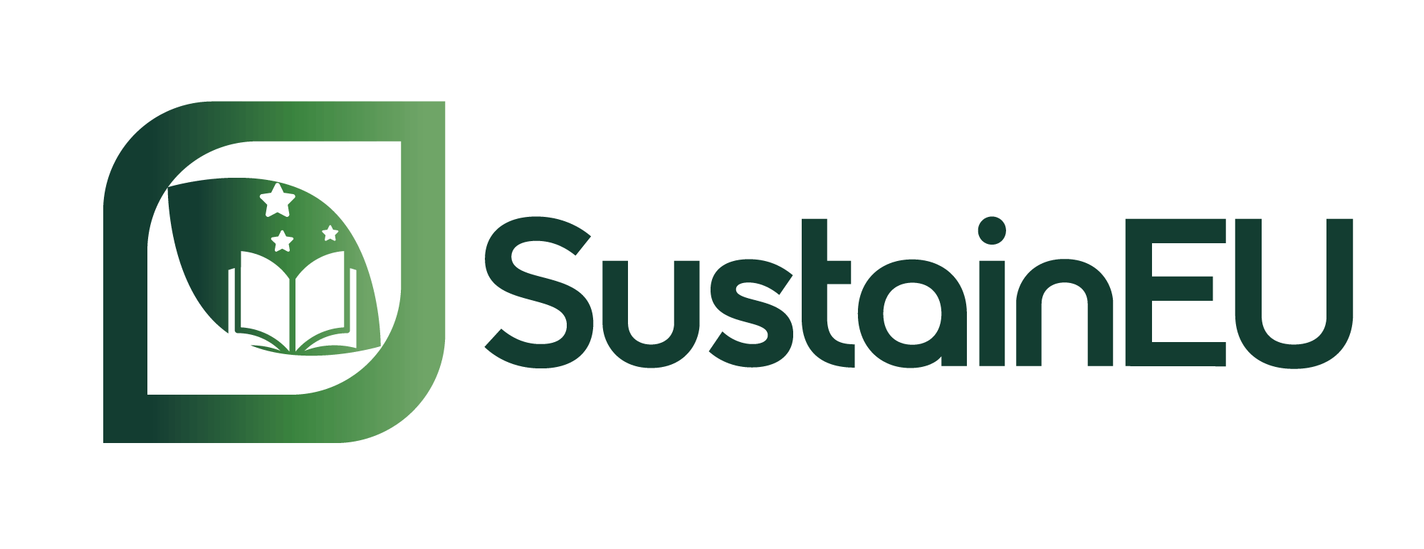

Train-the-Trainer
CPD Programme
Module 1: Introduction to Sustainability Concepts and Trends
Elaborated by: ISQ (Portugal)
Funded by the European Union. Views and opinions expressed are however those of the author(s) only and do not necessarily reflect those of the European Union or the European Education and Culture Executive Agency (EACEA). Neither the European Union nor EACEA can be held responsible for them. Project Number: 2024-1-PT01-KA220-VET-000252771

Slide 2
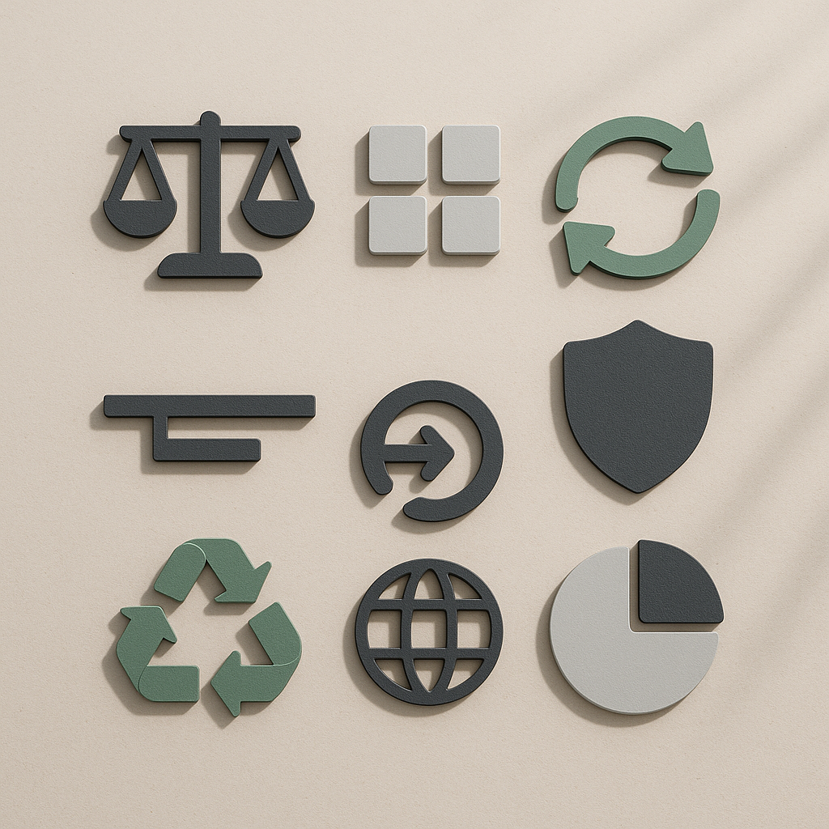
Session Roadmap
Today’s 3-hour session includes:
Welcome, module overview and learning outcomes (0–30 min)
Core content: sustainability concepts, trends and frameworks (30–75 min)
Practical activity: lesson plan design + micro-teaching (75–160 min)
Reflection and discussion (160–175 min)
Self-directed learning task briefing (175–180 min)
Notes:
Image source:
Image created with Sora (AI‑generated), for SUSTAIN‑EU CU4 “Module Aim & Introduction”. No third‑party content; no identifiable people or brands. Prompt archived in project records.

Slide 3
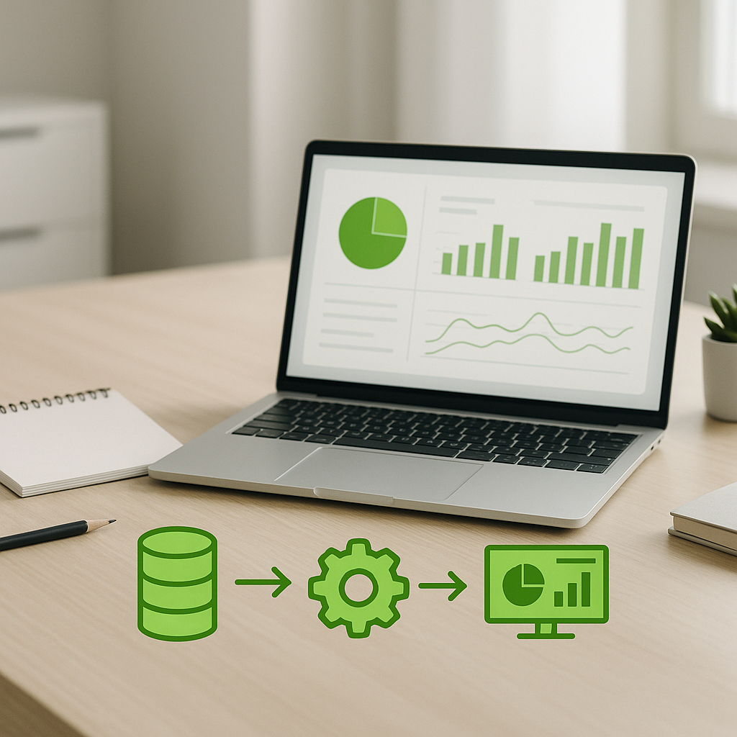
Module Overview
Present sustainability topics clearly, practically and inclusively
Design and deliver a short sustainability teaching session using ESE* content as your reference
By completing this module, trainers will be better prepared to:
Introduce sustainability concepts confidently using ESE materials
Connect them to real-world VET contexts, and
Design an inclusive lesson plan ready for delivery
*European Sustainability Course
Notes:
Image source:
Image created with Sora (AI‑generated), for SUSTAIN‑EU CU4 “Module Aim & Introduction”. No third‑party content; no identifiable people or brands. Prompt archived in project records.

Slide 4
Learning Outcomes
This module addresses the following Learning Outcomes:
K2 – Describe sustainability concepts, trends, and frameworks relevant to the VET context
K8 – Summarise accessibility, inclusivity and ethical requirements in online teaching and assessment
S1 – Design and deliver short learning sessions using SUSTAIN-EU materials and quality standards
AR5 – Promote accessibility and inclusion and facilitate reflective practice among learners

Slide 5
Opening Reflection / Warm-up
Think of one sustainability concept you already mention in your teaching- even briefly. How do you explain it to learners who have never heard of it?
Which sustainability topic do you feel least confident about? What would help?
What question do you expect your learners to ask that you are not sure how to answer yet?

Slide 6
What is Sustainability?

Slide 7
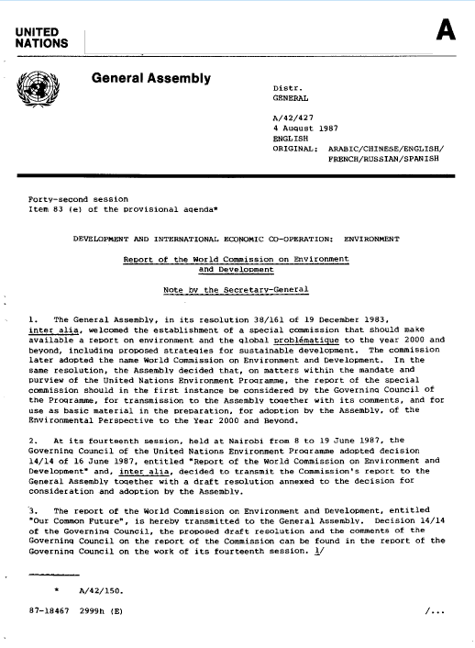
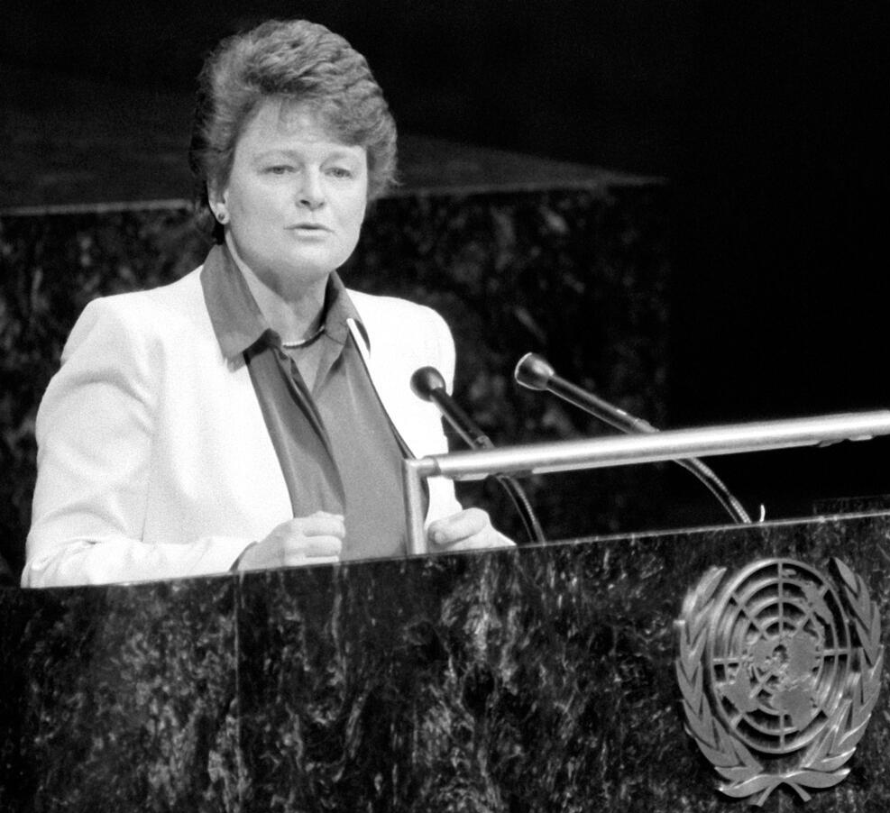
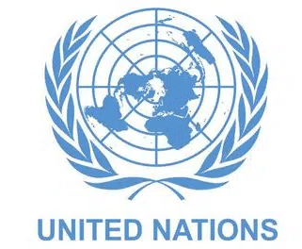
What is Sustainability?
Sustainable development
In 1987, the United Nations Brundtland Commission defined sustainable development as the “development that meets the needs of the present without compromising the ability of future generations to meet their own needs.”
Gro Harlem Brundtland, Prime Minister of Norway, addressing the UN General Assembly on Environment and Development
“Our Common Future”
UN report
Notes:
UC1
Image source: https://media.un.org/photo/en/asset/oun7/oun7702229
https://digitallibrary.un.org/record/139811?ln=en&v=pdf#files
Sustainable development requires an integrated approach that takes into consideration environmental concerns along with economic development.
In 1987, the United Nations Brundtland Commission defined sustainability as “meeting the needs of the present without compromising the ability of future generations to meet their own needs.” Today, there are almost 140 developing countries in the world seeking ways of meeting their development needs, but with the increasing threat of climate change, concrete efforts must be made to ensure development today does not negatively affect future generations.
The Sustainable Development Goals form the framework for improving the lives of populations around the world and mitigating the hazardous man-made effects of climate change. SDG 13: Climate Action, calls for integrating measures to prevent climate change within development frameworks. SDG 14: Life Below Water, and SDG 15: Life on Land, also call for more sustainable practices in using the earth’s natural resources.
https://www.un.org/en/academic-impact/sustainability

Slide 8
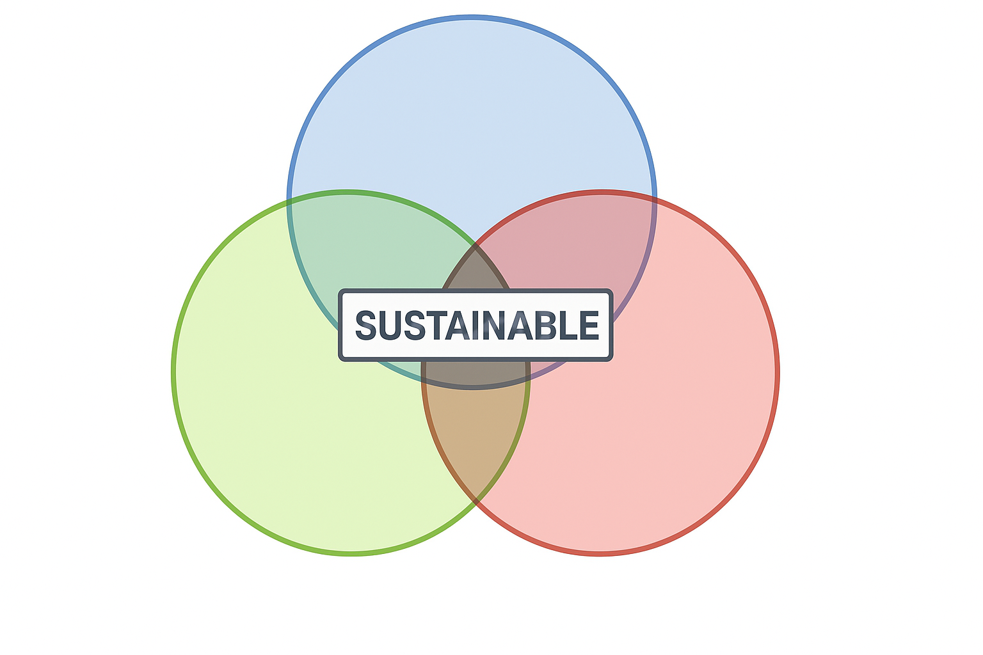
What is Sustainability?
Sustainability – Elkington’s triple bottom line
First published in 1997, John Elkington’s triple bottom line concept depicts a business world with outstanding performances in three main areas:
  Social
  Environmental, and
  Economic
rather than solely focusing on generating
profit, or the standard “bottom line.”
“Society”
“Bearable”
“Equitable”
“Environment”
“Economy”
“Viable”
Notes:
UC1
The triple bottom line is a business concept that states firms should commit to measuring their social and environmental impact—in addition to their financial performance—rather than solely focusing on generating profit, or the standard “bottom line.”
In 1994, the concept of triple bottom line was introduced into the business world as the new sustainability taxonomy embracing new guidelines for industries to undertake and address the set of sustainable development goals (SDGs) established in the United Nations Rio+20 summit and the following Millennium Development Goals (MDGs) from 2015 on. The concept was introduced as a new challenge for businesses to include security of people and the planet in the strategic business model and to develop new instruments and taxonomies to assess the prejudices that are being caused to society and environment (Griggs et al., 2013). In Cannibals with forks: The triple bottom line of 21st century business, Elkington (1997) postulates the 3Ps designation for people, planet, and profits as a triple goal toward true sustainability. By his definition, industries should assess the three segments when planning their strategies as all three of them are characterized by the same importance, not only accounting for the financial returns (Moneva, Archel, & Correa, 2006). To be successful in a truthful triple bottom line development, a company should consider having all three aspects with positive returns. Decreasing the level of negative outcomes is not considered by Elkington (1998) a solution to the environmental and societal problems we have been facing, as settled and established in the MDGs.
Dating back from 1997, Elkington’s concept has been constantly applied and reformulated in several contexts.
First published in 1997, Cannibals with forks: The triple bottom line of 21st century business (Elkington, 1997) depicts a business world with outstanding performances in three main areas: social, environmental, and economic.
25 Years Ago I Coined the Phrase “Triple Bottom Line.” Here’s Why It’s Time to Rethink It.
by John Elkington
June 25, 2018
https://hbr.org/2018/06/25-years-ago-i-coined-the-phrase-triple-bottom-line-heres-why-im-giving-up-on-it
Image source: https://www.researchgate.net/publication/299535510_Finding_the_Copper_Mine_of_the_21_st_Century_Conceptual_Exploration_Targeting_for_Hypothetical_Copper_Reserves

Slide 9
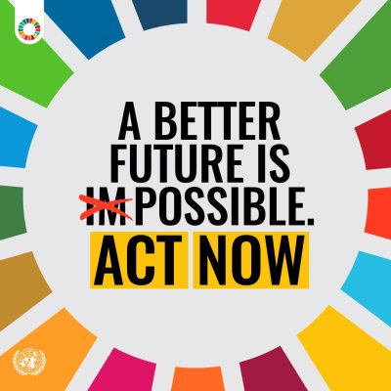
What is Sustainability?
The 2030 Agenda for Sustainable Development – Sustainable Development Goals
In 2015, UN Member States translated their vision of sustainable development into a blueprint for achieving it: the 2030 Agenda for Sustainable Development.
Its 17 Sustainable Development Goals —with ambitious targets to achieve by 2030— cover the three dimensions of sustainable development: the economy, social development and the environment.
Note: UN Sustainable Development Goals (SDGs) will be further addressed under UC2
Notes:
UC1
A blueprint for our common future
In 2015, UN Member States translated their vision of sustainable development into a blueprint for achieving it: the 2030 Agenda for Sustainable Development. Its 17 Sustainable Development Goals —with ambitious targets to achieve by 2030— cover the three dimensions of sustainable development: the economy, social development and the environment.
However, halfway to our 2030 deadline, the climate crisis, a weak global economy, conflicts and the lingering impact of COVID-19 have put the Goals in jeopardy.
According to the UN SDGs Report 2023: Special Edition, the number of people living in extreme poverty in 2020 rose to 724 million, and now gender equality is some 300 years away. The Intergovernmental Panel on Climate Change (IPCC) warns that without more robust policies across all sectors, the world is likely to surpass the critical 1.5°C tipping point by 2035.
It is not too late to reset efforts to reach them, however. To advance the sustainable development agenda, governments are integrating the Goals into national plans. However, a fundamental shift is needed to put the world on a better path. And with a few years left to achieve the 2030 Agenda, it is needed now.
Anyone can act
It is not only up to our world leaders. Every person can benefit from a more prosperous, inclusive and resilient world. We can all do something about it, regardless of whether we are in a government or civil society, run a business or a home, are in school or out of it.
While governments set policies to steer sustainable development, and both the public and private sectors have to finance the major shifts it requires, individual decisions add up fast. Your choices to earn a living, move around, make friends or advocate for justice can all make an impact. Want to know more? Find out how you can act now for our common future. Embrace the possible.
https://www.un.org/sustainabledevelopment/blog/2023/08/what-is-sustainable-development/
https://www.un.org/en/climatechange/act-our-common-future-working-together-sustainable-development-goals

Slide 10
UN Sustainability Development Goals (SDGs)
Purpose, meaning and significance
The United Nations Sustainable Development Goals (UN SDGs) are a set of 17 global goals adopted by all UN member states in 2015, as part of the 2030 Agenda for Sustainable Development.
The SDGs provide a universal framework for countries, organizations, and individuals to work together toward a better future.
They aim to end poverty, protect the planet, and ensure prosperity and peace for all by 2030.
The SDGs’ significance spreads on multiple levels:
Comprehensive: they cover social, economic, and environmental dimensions of development — from eradicating poverty and hunger to promoting education, equality, clean energy, and climate action.
Universal: They apply to all countries, rich and poor alike, emphasizing shared responsibility.
Measurable: Each goal has specific targets and indicators to track progress.
Transformative: The SDGs encourage systemic change — sustainable economies, inclusive societies, and environmental stewardship.
The UN SDGs serve as a global blueprint for building a more just, equitable, and sustainable world by 2030!

Slide 11
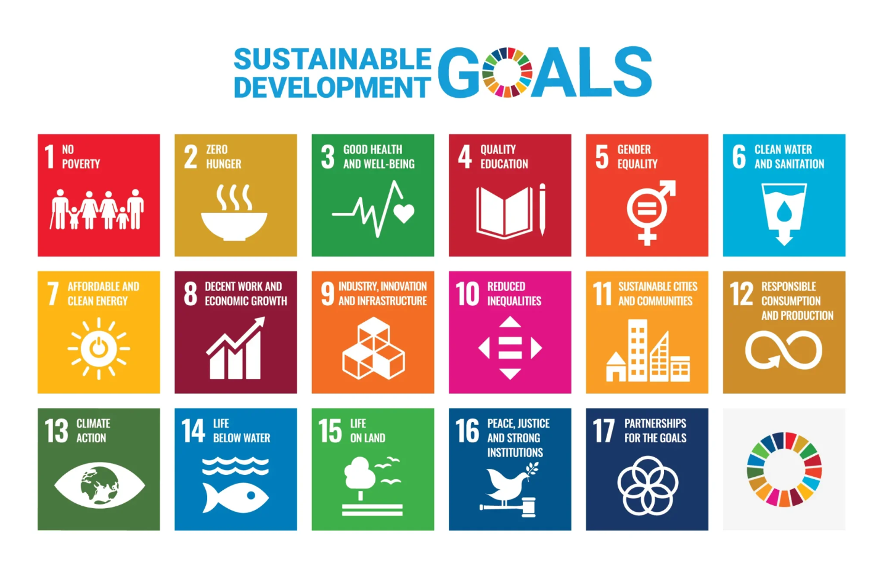
UN Sustainability Development Goals (SDGs)
https://youtu.be/0XTBYMfZyrM?si=MiepkXaPSvUXZIDp

Slide 12
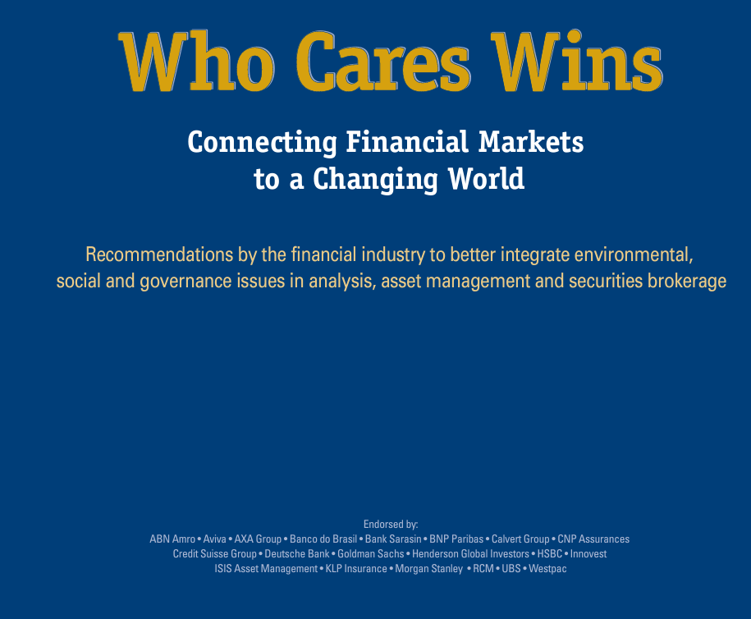

What is Sustainability?
ESG - Environment, Social, and Governance
The acronym ESG was created in 2004
The UN Global Compact report, "Who Cares Wins," resulted from a joint initiative of financial institutions (18)
They developed guidelines and recommendations on how to best integrate Environmental, Social, and Governance (ESG) value drivers in asset management and financial research – Investing for Long-Term Value.
Notes:
UC1
https://www.unglobalcompact.org/docs/issues_doc/Financial_markets/who_cares_who_wins.pdf
The Who Cares Wins conference in 2005 first brought together institutional investors, asset managers, buy-side and sell-side research analysts, global consultants and government bodies and regulators to examine the role of environmental, social and governance (ESG) value drivers in asset management and financial research. There was a remarkable degree of agreement among participants that ESG factors play an important role in the context of longer-term investment.

Slide 13
Key Sustainability Trends

Slide 14
Key Sustainability Trends
EU Climate Targets until 2030-2040-2050
In 2023, the EU adopted a set of Commission proposals to make the EU's climate, energy, transport and taxation policies fit for reducing net greenhouse gas emissions by at least 55% by 2030, compared to 1990 levels.
In 2025, the European Commission proposed as target reducing the EU’s net greenhouse gas (GHG) emissions by 90% by 2040, relative to 1990.
The EU aims to be climate-neutral by 2050 - an economy with net-zero greenhouse gas emissions. This objective is at the heart of the European Green Deal, and is a legally binding target thanks to the European Climate Law.
Read here: https://climate.ec.europa.eu/eu-action/climate-strategies-targets_en
Notes:
M2 - 49

Slide 15
Key Sustainability Trends
EU legislative framework on Climate Change
European Climate Law (2021) + the following:
European Green Deal (2019): aims to cut emissions by at least 50% by 2030, rising towards 55%, while legally binding the 2050 neutrality goal through the European Climate Law.
Fit for 55: a set of laws aiming to reduce EU greenhouse gas emissions by at least 55% by 2030.
EU Adaptation Strategy (2021): aims at helping the EU to become climate-resilient.
𝐶𝑂₂ emissions from transport (2019): new rules and stricter emission limits for cars and vans .
EU Emissions Trading System – EU ETS (2018): sets a cap on how much 𝐶𝑂₂ heavy industry and power stations can emit.
Effort Sharing Regulation (2018): sets binding targets for annual GHG emission reductions from sectors falling outside the scope of the EU emissions trading system are regulated.
Land Use and Forestry (2018): regulations to improve the protection & management of land & forests.
Clean Energy (2020): sets strategies for decarbonisation of the energy sector.
Read here: https://www.consilium.europa.eu/en/policies/climate-change/eu-climate-action/ ; https://climate.ec.europa.eu/eu-action/eu-competences-field-climate-action_en
Notes:
M2-50

Slide 16
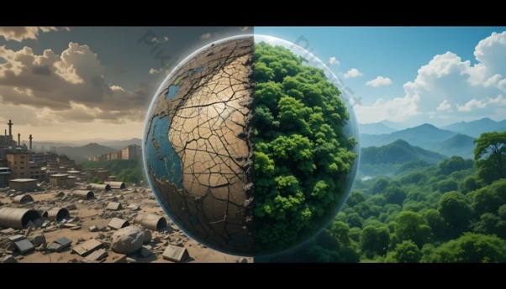
Key Sustainability Trends
Greenhouse-gases (GHG
Greenhouse gases (GHG) are atmospheric gases that trap heat from the sun, preventing it from escaping into space and causing the planet to warm, a process known as the greenhouse effect.
The main GHGs include carbon dioxide (CO₂), methane (CH₄), nitrous oxide (N₂O), and fluorinated gases, produced primarily through burning fossil fuels, agriculture, and industrial processes.
The rapid increase of GHG concentrations since the Industrial Revolution is the principal driver of climate change, with far-reaching consequences for ecosystems, human health, food security, and the global economy.

Slide 17
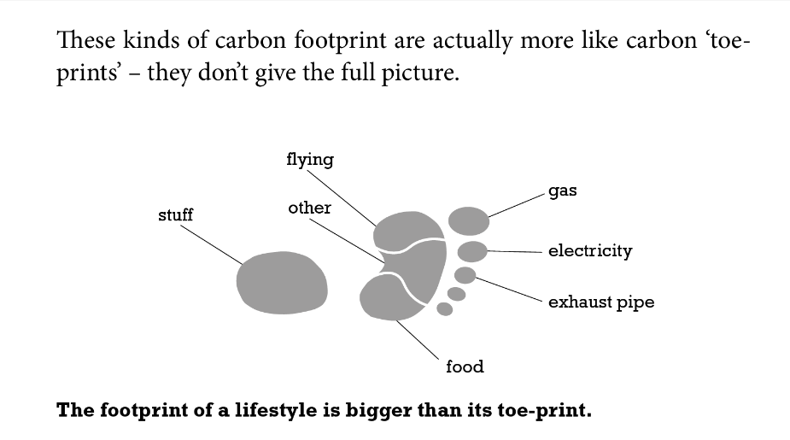
Key Sustainability Trends
The carbon footprint is “the sum total of all the greenhouse gas emissions that had to take place in order for a product to be produced or for an activity to take place.” (Berners-Lee, 2020)
Products and activities that produce carbon footprint:
household energy use
transport
food
everything else
A person’s carbon footprint is the combined total of the products they buy and use, the activities they undertake.
Unsurprisingly, in general terms the size of a person’s carbon footprint tends to increase with wealth.
Carbon footprint calculators: from the Nature Conservancy; from the United States Environmental Protection Agency
Notes:
Image source: Mike Berners-Lee, (2020). The carbon Footprint of Everything. Profile Books Ltd., London. ISBN 978-1788163811, eISBN 978-1782837114

Slide 18
Key Sustainability Trends
Carbon credits are tradable instruments (typically a virtual certificate) that convey a claim to avoided greenhouse gas (GHG) emissions or enhanced GHG removals.
1 Carbon Credit = one tone of carbon dioxide equivalent (𝐶𝑂₂𝑒 )
(a single carbon credit is equivalent to the removal or avoidance of one tone of carbon dioxide or its equivalent in other greenhouse gases).
Carbon credits are generated by projects like renewable energy or reforestation, and companies buy them to offset their own emissions and support climate action.
Once a credit is purchased and retired, it ensures the reduction is permanent and cannot be reused.
Watch this video: ClimateChange_CarbonCredits_CarbonOffsetingProjects
Read here: Carbon Offset Guide

Slide 19
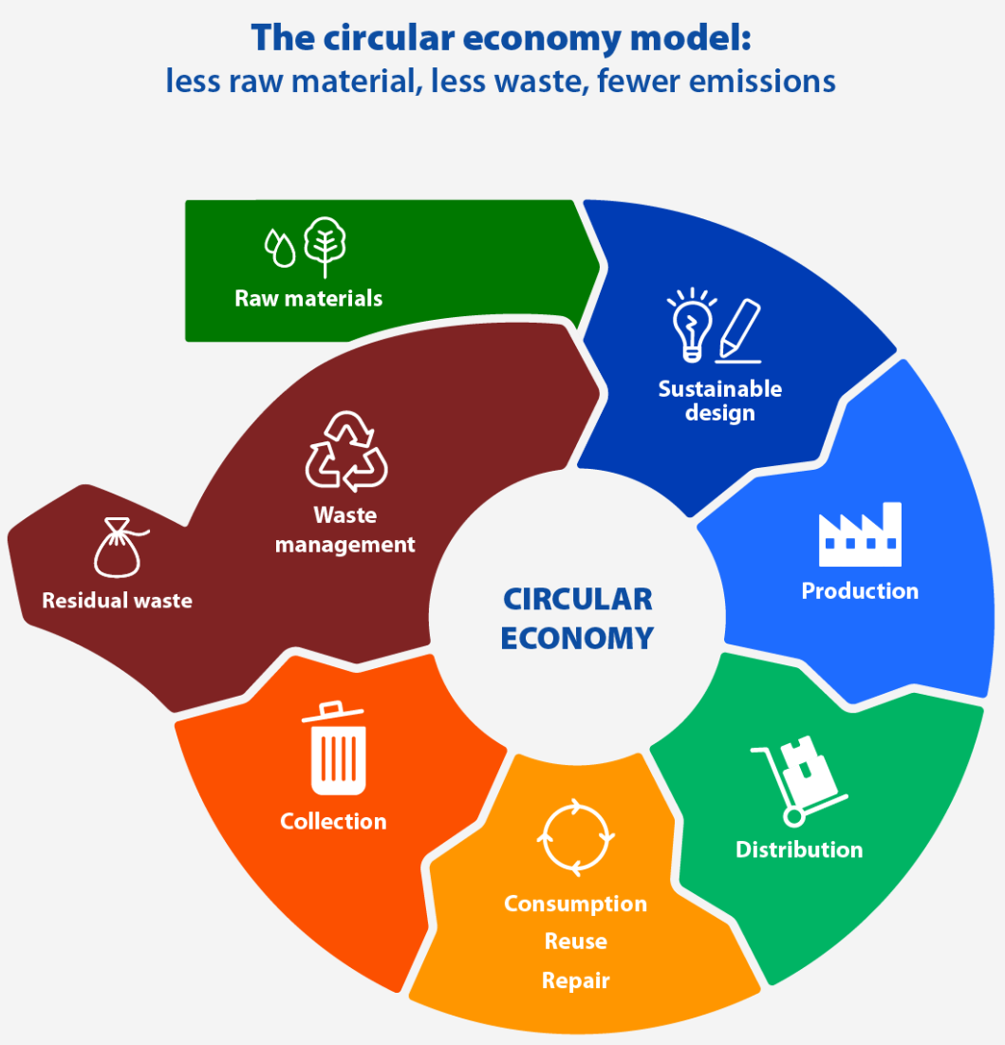
Key Sustainability Trends
Circular Economy
Picture
Circular economy is a model of production and consumption
The life cycle of products is extended
It implies, for example:
  reducing waste to a minimum
  recycling materials of products that reach the end of its life
And generates benefits, such as:
  slows down the use of natural resources,
  reduces landscape and habitat disruption and helps to limit biodiversity loss
  contributes to reduce GHG emissions
  reduces raw materials dependency and helps to mitigate the risks associated with supply chains
Trainer tip: Ask learners to identify one product they use at work and trace where it goes at end of life. This makes circular economy tangible and sector-specific. The 10 R’s framework gives learners a practical decision-making tool - refer them to it.
Notes:
UC3
Image source: European Parliament Research Service
Circular economy is a model of production and consumption, which involves sharing, leasing, reusing, repairing, refurbishing and recycling existing materials and products
The circular economy is a model of production and consumption, which involves sharing, leasing, reusing, repairing, refurbishing and recycling existing materials and products as long as possible. In this way, the life cycle of products is extended.
In practice, it implies reducing waste to a minimum. When a product reaches the end of its life, its materials are kept within the economy wherever possible thanks to recycling. These can be productively used again and again, thereby creating further value.
This is a departure from the traditional, linear economic model, which is based on a take-make-consume-throw away pattern. This model relies on large quantities of cheap, easily accessible materials and energy.
Also part of this model is planned obsolescence, when a product has been designed to have a limited lifespan to encourage consumers to buy it again. The European Parliament has called for measures to tackle this practice.
Circular economy: definition, importance and benefits
https://www.europarl.europa.eu/topics/en/article/20151201STO05603/circular-economy-definition-importance-and-benefits

Slide 20
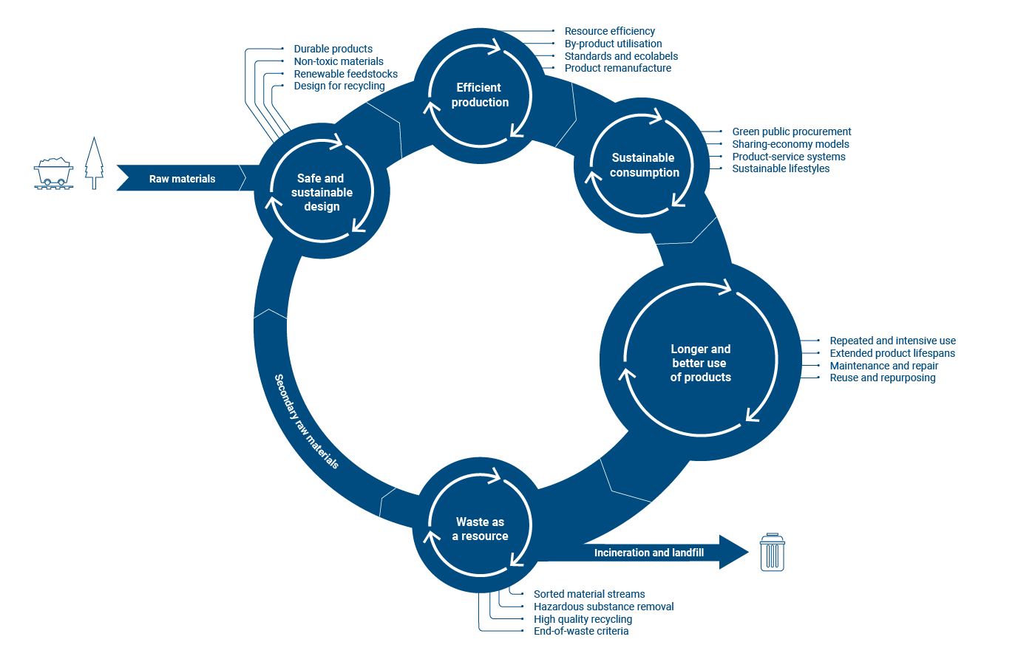
Key Sustainability Trends
The EC’s Circular Economy Action Plan
recognises circular economy as a prerequisite for climate neutrality.
The extraction and processing of materials account for around 50% of global GHG emissions - key aim of the circular economy is to retain the value of products and materials in use for as long as possible
  reduce the demand for virgin materials
  safe and sustainable design
  efficient production
  sustainable consumption
  longer and better use of products
  using waste as a resource
  energy-intensive parts of the circular economy powered by renewable energy
Notes:
UC3
Suggestion of practical activity (Activity 4): Circular economy – Stakeholders mapping in the textile sector
Image source: European Environmental Agency (EEA)
https://www.eea.europa.eu/publications/capturing-the-climate-change-mitigation
The European Commission Circular Economy action Plan (2020)
COMMUNICATION FROM THE COMMISSION TO THE EUROPEAN PARLIAMENT, THE COUNCIL, THE EUROPEAN ECONOMIC AND SOCIAL COMMITTEE AND THE COMMITTEE OF THE REGIONS A new Circular Economy Action Plan For a cleaner and more competitive Europe
https://eur-lex.europa.eu/legal-content/EN/TXT/?qid=1583933814386&uri=COM:2020:98:FIN
Circular economy’s potential key role in climate change mitigation
The International Resource Panel (IRP, 2019) highlights that the extraction and processing of materials (fossil fuels, biomass, metals and non-metallic minerals) account for around 50% of global GHG emissions. A key aim of the circular economy is to retain the value of products and materials in use for as long as possible.
This key aim would reduce the demand for virgin materials and the GHGs emitted during their extraction and processing. In addition, the energy-intensive parts of the circular economy should be powered by renewable energy.
This can happen through a series of actions along the whole value chain, including via safe and sustainable design, efficient production, sustainable consumption, longer and better use of products and using waste as a resource (Figure 1). By 2022, about 22 Member States had adopted a dedicated circular economy strategy.
The 2020 circular economy action plan (COM/2020/98 final) of the European Commission recognises this interlinkage between the circular economy and climate policies, presenting circularity as a prerequisite for climate neutrality.
This approach is further acknowledged from the climate perspective, where guidelines for updating national energy and climate plans (NECPs) emphasise the importance for Member States to start ‘integrating and modelling the contribution of the circular economy to the climate transition’.

Slide 21
The 10 R’s of the Circular Economy
Key Sustainability Trends
The 10 "R" strategies guide circular thinking.
These 10 Rs represent practical actions to minimise resource use, extend product life, and close the loop
Intended to help organisations prioritise actions to increase circularity performance
Brings a life cycle perspective to guide the organisation in identifying the most effective strategy
Different tools, such as ISO Circular Economy standards (ISO 59000 series) provide a strategic framework to support this transition
Notes:
UC3
Image Source: Ellen MacArthur Foundation
The butterfly diagram: visualising the circular economy
https://www.ellenmacarthurfoundation.org/circular-economy-diagram

Slide 22
The 10 R’s of the Circular Economy
Key Sustainability Trends
Goal | Strategy | Description
Smart product use and manufacture | R0 – Refuse | Make product redundant by abandoning its function or offering same function with radically different product.
 | R1 – Rethink | Make product use more intense (e.g., product-sharing, multi-functional product).
 | R2 – Reduce | Increase efficiency in product manufacture or use by consuming fewer natural resources and materials.
Extend lifespan of product and its part | R3 – Reuse | Reuse of functional discarded product by another consumer.
 | R4 – Repair | Repair and maintenance of defective product to restore its original function.
 | R5 – Refurbish | Restore an old product to bring it up to date.
 | R6 – Remanufacture | Use product or parts in a new product with its original function.
 | R7 – Repurpose | Use product or parts in a new product with a different function.
Useful application of materials | R8 – Recycle | Process the materials to obtain the same (high grade) or lower (low grade) quality.
 | R9 – Recover | Incinerate materials to recover energy.
A Compass for Sustainable
Transformation
Image source: Kupfer, R., et. al. 2022. Neutral lightweight engineering: a holistic approach towards sustainability driven engineering. Discover Sustainability. DOI: 10.1007/s43621-022-00084-9 10 R-strategies ordered for priority according to their levels of circularity
EEA - Strategies for increased circularity within the product chain https://www.eea.europa.eu/publications/capturing-the-climate-change-mitigation
Notes:
UC3
Image source: Kupfer, R., et. al. 2022. Neutral lightweight engineering: a holistic approach
towards sustainability driven engineering. Discover Sustainability. DOI: 10.1007/s43621-022-00084-9
10 R-strategies ordered for priority according to their levels of circularity
EEA - Strategies for increased circularity within the product chain
https://www.eea.europa.eu/publications/capturing-the-climate-change-mitigation

Slide 23
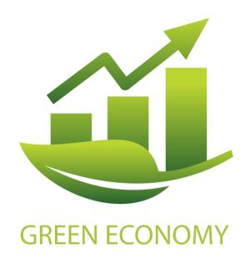
Green economy
Key Sustainability Trends
A green economy is defined as low carbon, resource efficient and socially inclusive.
In a green economy, growth in employment and income are driven by public and private investment into such economic activities, infrastructure and assets that allow reduced carbon emissions and pollution, enhanced energy and resource efficiency, and prevention of the loss of biodiversity and ecosystem services.
Trainer tip: Connect the green economy to your learners’ sectors: Which green jobs are growing in construction, energy, logistics or agriculture in your country?
Notes:
UC1 - 36
Image Source: https://sustainabledevelopment.un.org/partnerships/greeneconomy
https://www.unep.org/regions/asia-and-pacific/regional-initiatives/supporting-resource-efficiency/green-economy
A green economy is defined as low carbon, resource efficient and socially inclusive. In a green economy, growth in employment and income are driven by public and private investment into such economic activities, infrastructure and assets that allow reduced carbon emissions and pollution, enhanced energy and resource efficiency, and prevention of the loss of biodiversity and ecosystem services.
These green investments need to be enabled and supported through targeted public expenditure, policy reforms and changes in taxation and regulation. UN Environment promotes a development path that understands natural capital as a critical economic asset and a source of public benefits, especially for poor people whose livelihoods depend on natural resources. The notion of green economy does not replace sustainable development, but creates a new focus on the economy, investment, capital and infrastructure, employment and skills and positive social and environmental outcomes across Asia and the Pacific.

Slide 24
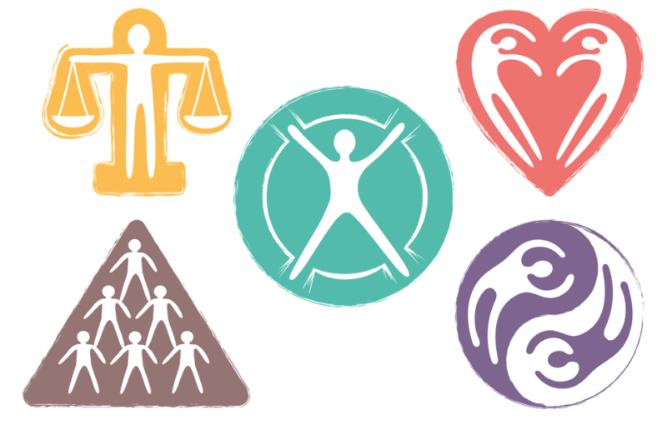
Green economy
Key Sustainability Trends
The 5 Principles of Green Economy
Exploring what a green and fair economy looks like in principle - and in practice
The Wellbeing Principle - a green economy enables all people to create and enjoy prosperity.
The Justice Principle - the green economy promotes equity within and between generations.
The Planetary Boundaries Principle - the green economy safeguards, restores and invests in nature.
The Efficiency and Sufficiency Principle - the green economy is geared to support sustainable consumption and production.
The Good Governance Principle - the green economy is guided by integrated, accountable and resilient institutions.
Notes:
UC1 - 38
Image source: https://www.greeneconomycoalition.org/news-and-resources/the-5-principles-of-green-economy
https://www.greeneconomycoalition.org/news-and-resources/the-5-principles-of-green-economy
The 5 Principles of Green Economy
Exploring what a green and fair economy looks like in principle - and in practice
Humanity faces serious challenges in the coming decades: climate change, biodiversity loss, growing inequality, and more. These systemic global crises cannot be tackled in isolation, because they are all interconnected. But our economic systems are not fit enough to deliver a good balance of environmental and social goals
Economies are, at heart, a collection of rules and norms that reward some behaviours and punish others. In their current form, our economies incentivise overconsumption, degrade communal bonds, and destroy natural wealth. But this is not inevitable or unavoidable; it is simply how our economies have evolved to operate. To solve these problems, a new economic vision is required.
The vision: a fair, green economic future
Our vision of a green economy is one that provides prosperity for all within the ecological limits of the planet. It follows five key principles, each of which draws on important precedents in international policy, and which together can guide economic reform in diverse contexts.
1. The Wellbeing Principle
A green economy enables all people to create and enjoy prosperity.
. The green economy is people-centred. Its purpose is to create genuine, shared prosperity.
. It focuses on growing wealth that will support wellbeing. This wealth is not merely financial, but includes the full range of human, social, physical and natural capitals.
. It prioritizes investment and access to the sustainable natural systems, infrastructure, knowledge and education needed for all people to prosper.
. It offers opportunities for green and decent livelihoods, enterprises and jobs.
. It is built on collective action for public goods, yet is based on individual choices
2. The Justice Principle
The green economy promotes equity within and between generations.
. The green economy is inclusive and non-discriminatory. It shares decision-making, benefits and costs fairly; avoids elite capture; and especially supports women’s empowerment.
. It promotes the equitable distribution of opportunity and outcome, reducing disparities between people, while also giving sufficient space for wildlife and wilderness.
. It takes a long-term perspective on the economy, creating wealth and resilience that serve the interests of future citizens, while also acting urgently to tackle today’s multi-dimensional poverty and injustice.
. It is based on solidarity and social justice, strengthening trust and social ties, and supporting human rights, the rights of workers, indigenous peoples and minorities, and the right to sustainable development.
. It promotes empowerment of MSMEs, social enterprises, and sustainable livelihoods.
. It seeks a fast and fair transition and covers its costs – leaving no-one behind, enabling vulnerable groups to be agents of transition, and innovating in social protection and reskilling.
3. The Planetary Boundaries Principle
The green economy safeguards, restores and invests in nature.
. An inclusive green economy recognizes and nurtures nature’s diverse values – functional values of providing goods and services that underpin the economy, nature’s cultural values that underpin societies, and nature’s ecological values that underpin all of life itself.
. It acknowledges the limited substitutability of natural capital with other capitals, employing the precautionary principle to avoid loss of critical natural capital and breaching ecological limits.
. It invests in protecting, growing and restoring biodiversity, soil, water, air, and natural systems.
. It is innovative in managing natural systems, informed by their properties such as circularity, and aligning with local community livelihoods based on biodiversity and natural systems.
4. The Efficiency and Sufficiency Principle
The green economy is geared to support sustainable consumption and production.
. An inclusive green economy is low-carbon, resource-conserving, diverse and circular. It embraces new models of economic development that address the challenge of creating prosperity within planetary boundaries.
. It recognises there must be a significant global shift to limit consumption of natural resources to physically sustainable levels if we are to remain within planetary boundaries.
. It recognizes a ‘social floor’ of basic goods and services consumption that is essential to meet people’s wellbeing and dignity, as well as unacceptable ‘peaks’ of consumption.
. It aligns prices, subsidies and incentives with true costs to society, through mechanisms where the ‘polluter pays’ and/or where benefits accrue to those who deliver inclusive green outcomes.
5. The Good Governance Principle
The green economy is guided by integrated, accountable and resilient institutions.
. An inclusive green economy is evidence-based – its norms and institutions are interdisciplinary, deploying both sound science and economics along with local knowledge for adaptive strategy.
. It is supported by institutions that are integrated, collaborative and coherent – horizontally across sectors and vertically across governance levels – and with adequate capacity to meet their respective roles in effective, efficient and accountable ways
. It requires public participation, prior informed consent, transparency, social dialogue, democratic accountability, and freedom from vested interests in all institutions – public, private and civil society – so that enlightened leadership is complemented by societal demand.
. It promotes devolved decision-making for local economies and management of natural systems while maintaining strong common, centralized standards, procedures, and compliance systems.
. It builds a financial system with the purpose of delivering wellbeing and sustainability, set up in ways that safely serve the interests of society.

Slide 25

Digital transition
Key Sustainability Trends
Picture
Digitalisation supports dematerialisation
Europe’s digital transition goes hand in hand with the European Green Deal
Digital technologies (WEF, 2022):
  could reduce emissions by 20% by 2050 in the three highest-emitting sectors: energy, materials, and mobility
  these industries can already reduce emissions by 4-10% by 2030 by accelerating the adoption of digital technologies
  data transparency, digital talent and partnership will be key ingredients to technology adoption at scale
Notes:
UC3 - 34
Image source: Numen (https://www.numen.fr/quest-ce-que-la-dematerialisation-definition)
World Economic Forum
Digital solutions can reduce global emissions by up to 20%. Here’s how
(2022)
https://www.weforum.org/stories/2022/05/how-digital-solutions-can-reduce-global-emissions/#:~:text=If%20brought%20to%20scale%2C%20digital,the%20adoption%20of%20digital%20technologies.
European Green Deal – https://commission.europa.eu/strategy-and-policy/priorities-2019-2024/european-green-deal_en
The European Green Deal will transform the EU into a modern, resource-efficient and competitive economy.
Green digital sector
https://digital-strategy.ec.europa.eu/en/policies/green-digital
Shaping Europe's digital future
https://commission.europa.eu/strategy-and-policy/priorities-2019-2024/europe-fit-digital-age/shaping-europes-digital-future_en

Slide 26
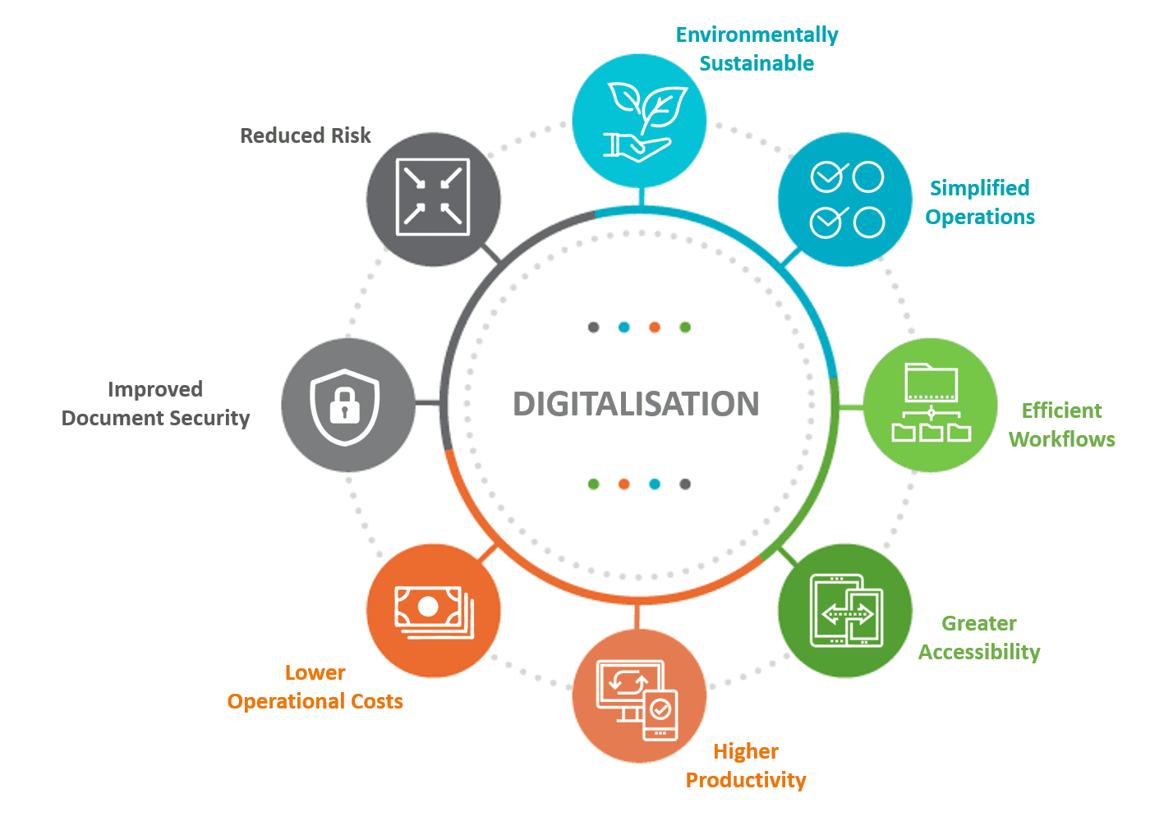
Digital transition
Key Sustainability Trends
Digitalisation supports dematerialisation
Digital solutions:
open up new opportunities for businesses
encourage the development of trustworthy technology
foster an open and democratic society
enable a vibrant and sustainable economy
help fight climate change and achieve the green transition
Notes:
UC3 - 35
Image source: GreenOffice (https://greenoffice.co.za/digitalisation/)
Shaping Europe's digital future
The digital transition should work for all, putting people first and opening new opportunities for business. Digital solutions are also key to fighting climate change and achieving the green transition.
https://commission.europa.eu/strategy-and-policy/priorities-2019-2024/europe-fit-digital-age/shaping-europes-digital-future_en

Slide 27
Sustainability Frameworks for VET

Slide 28
Sustainability Frameworks for VET
GreenComp | the European sustainability competence framework
GreenComp defines essential sustainability competences, guiding curricula and pedagogical practices across Europe. It serves as a reference for developing green competences across different educational contexts.
DigCompEdu |Digital Competence Framework for Educators
DigCompEdu is the European framework for the digital competence of educators, describing 22 competences across 6 areas and guiding the pedagogical use of technologies in teaching, assessment, inclusion, and the creation and sharing of resources. It provides the didactic-digital means (planning, mediation, assessment) for educators to integrate sustainability into effective and accessible practices in VET.
DigCompEdu |Digital Competence Framework for Educators
LifeComp is the European Framework for Personal, Social and Learning to Learn Competences, developed by the Joint Research Centre (JRC). It defines 9 competences across three areas — Personal (growth mindset, wellbeing, self-regulation), Social (empathy, communication, collaboration), and Learning to Learn (reflection, critical thinking, flexible thinking). In a VET and sustainability context, LifeComp supports learners in developing the personal resilience, collaborative capacity and reflective practice needed to navigate complex sustainability challenges and transitions in the workplace.

Slide 29
Sustainability Frameworks for VET
GreenComp tells you WHAT to teach.
DigCompEdu tells you HOW to teach it.
LifeComp tells you WHO you are teaching.

Slide 30
Teaching Sustainability Inclusively
Practical principles for your training sessions:
Use the ESE Glossary - define terms consistently, do not improvise new definitions
Choose examples from your learners’ sectors - the ESE course covers multiple industries; make it relevant to construction, logistics, hospitality or whatever your group knows
Acknowledge complexity without creating anxiety. Normalise the challenge, break it into steps, focus on what learners can do

Slide 31
Checkpoint Discussion
Which sustainability concept do you feel most confident explaining to VET learners? Why?
Which concept do you find hardest to make relevant for your learner group and how might you address that?
How does the Triple Bottom Line or GreenComp framework connect to a real job role your learners might have?

Slide 32

Practical Activity
Design Your Sustainability Lesson Plan
Participants will:
Choose one concept: Triple Bottom Line | Circular Economy | Green Economy | SDGs| ESG …
Complete the Lesson Plan template (Annex 1): learning objective, real-world example, key question for learners
Deliver your 5-minute lesson plan to the group (micro-teaching); peers give structured feedback using the feedback sheet
Working format: groups of 3–4
Time: 85 minutes total (30 min design + 30 min micro-teaching + 25 min debrief)
Materials: Lesson Plan template (Annex 1), peer feedback sheet

Slide 33
Practical Activity Output
By the end of the activity, participants should produce:
Completed Lesson Plan (learning objective + definition + example + inclusion note)
Micro-teaching delivery — 5-minute presentation of your lesson plan to peers
Peer feedback notes received on your delivery
This output may contribute to the Trainer Portfolio.
Examples:
Lesson plan → Trainer Portfolio (mandatory minimum)
Micro-teaching activity → Trainer Portfolio (mandatory minimum)
Reflection note on inclusive teaching → Trainer Portfolio

Slide 34
Reflection Questions
Reflection questions:
How confident do you feel explaining your chosen concept to a learner who has never heard of it? What would you need to know better?
ESE CU1 opens with organisational sustainability — your learners may arrive sceptical, overwhelmed or already engaged. How will you read the room in the first 10 minutes?
Which ESE concept will be hardest to make relevant for your specific learner group — and why?
Inclusion check: is there anything in how you explained your concept today that might have excluded a learner from a different background, sector or language level?

Slide 35
Self-Directed Learning Task
My Sustainability Learning Activity
Duration: 1 hour
Choose one concept you feel least confident about. Review the slides and the Technical Glossary definition.
Design a short learning activity tailored to your own professional VET context, through which your learners can understand and apply one sustainability concept.
  The sustainability concept you want learners to grasp (e.g. energy efficiency, circular economy, carbon footprint).
  The learning activity you would propose (e.g. discussion, case analysis, practical task, problem-based scenario), explaining what learners will do.
  A connection to a real or local context, ensuring relevance to your learners’ field or sector.
  How you will ensure inclusivity, considering different learner needs, backgrounds, or levels of prior knowledge.
The activity should be simple, practical, and directly usable in your teaching practice, helping learners not only understand the concept but also relate it to their professional reality

Slide 36
Self-Directed Learning Task
My Sustainability Learning Activity
Duration: 1 hour
A short description of a tailored learning activity (approx. 150–200 words) designed for the trainer’s own VET context, in which learners engage with and apply one sustainability concept.
The output should include:
a clear outline of the activity (what learners will do)
a connection to a relevant real-world or sector-specific context and an indication of how inclusivity will be ensured
The activity should be practical, ready to implement, and support learners in understanding and applying sustainability concepts within their professional reality

Slide 37
Summary and Next Steps
In this module, we covered:
Sustainability = TBL (Environmental + Social + Economic) + SDGs + ESG
Key trends covered: European Green Deal, GHG , Circular Economy (10 R’s), Green Economy, Digital–Green transition
Three EU frameworks guide how you teach: GreenComp (WHAT), DigCompEdu (HOW), LifeComp (WHO).
Next steps:
Complete the SDL task: My Sustainability Teaching Prompt (1 hour)
Submit your Lesson Plan + Reflection Note to the Trainer Portfolio
Prepare for Module 2: Navigating the SUSTAIN-EU Curriculum and E-Learning Course (SRC)
Notes:
Image source:
Image created with Sora (AI‑generated), for SUSTAIN‑EU CU4 “Module Aim & Introduction”. No third‑party content; no identifiable people or brands. Prompt archived in project records.

Slide 38
















Funded by the European Union. Views and opinions expressed are however those of the author(s) only and do not necessarily reflect those of the European Union or the European Education and Culture Executive Agency (EACEA). Neither the European Union nor EACEA can be held responsible for them. Project Number: 2024-1-PT01-KA220-VET-000252771

